Slide 1
IT Franchise Current State Assessment Outline
Leke Adekoya
Acting MD iQx Consult Ltd
June 2020

Slide 2
Proposed outline for IT Assessment
Executive Summary
3.
Current State Assessment : The Approach
4.
Current State Assessment: Maturity Rating Definitions
10.
Detailed Current State Assessment
11.
Summary Gap Assessment
35.
Future State Implementation Plan
39.
Bridging the Gap & Our Aspiration
78.
Appendix
84.

Slide 3

Executive Summary
Introduction to Current State Assessment
The Approach
In line with FMDQ’s drive for operational excellence, it was imperative to carry out a Current State Assessment (CSA) and Operation readiness of iQx Consult Limited franchise of the FMDQ Group. This assessment is necessary to ensure the business is well positioned and has the capacity to deliver on its mandate – to drive the technology infrastructure as an offshoot of the ITD division of FMDQ.
We focused on nine (9) key areas of IT while also leveraging on Gartner’s IT score for CIOs. Gartner Score enables organisations to improve functional performance by assessing their performance across a broad set of functional activities. The diagnostic measures two primary dimension: maturity and importance. IT Score for CIOs covers thirty (30) functional activities across seven (7) functional objectives.
The functional activities was absorbed into the nine (9) key areas to provide an holistic view of iQx current state.
What is our current State Assessment?
Our current state assessment takes cognizance of these key areas of IT necessary to position iQx to run the FMDQ group technology business and subsequently be a leading provider of financial market digitisation. Different ratings was assigned to these areas depending on the level of maturity and compliance
IT Governance
People and Skills
IT Strategy
Digital Readiness
Technology
Enterprise Architecture
IT Security
Business Intelligence
IT Infrastructure

Slide 4













Tech trends
WE ARE SEEING A SHIFT BOTH GLOBALLY AND LOCALLY WITH NEW SERVICES THAT ARE CHANGING CUSTOMER’S EXPERIENCE AND EXPECTATIONS
SERVICES THAT ARE CREATING NEW FORMS OF ACCESS FOR CUSTOMERS
SERVICES THAT ARE PULLING SERVICES TOGETHER AND CHANGING THE MARKET PLACE
SERVICES THAT ARE REDEFINING THE ROLE OF CUSTOMER ADVICE AND SERVICE

Slide 5













Tech trends ../2
PARTNERSHIPS ARE BECOMING A CRITICAL COMPONENT FOR SUCCESS…
+
+
+
+
+
42 BANKS
+

Slide 6
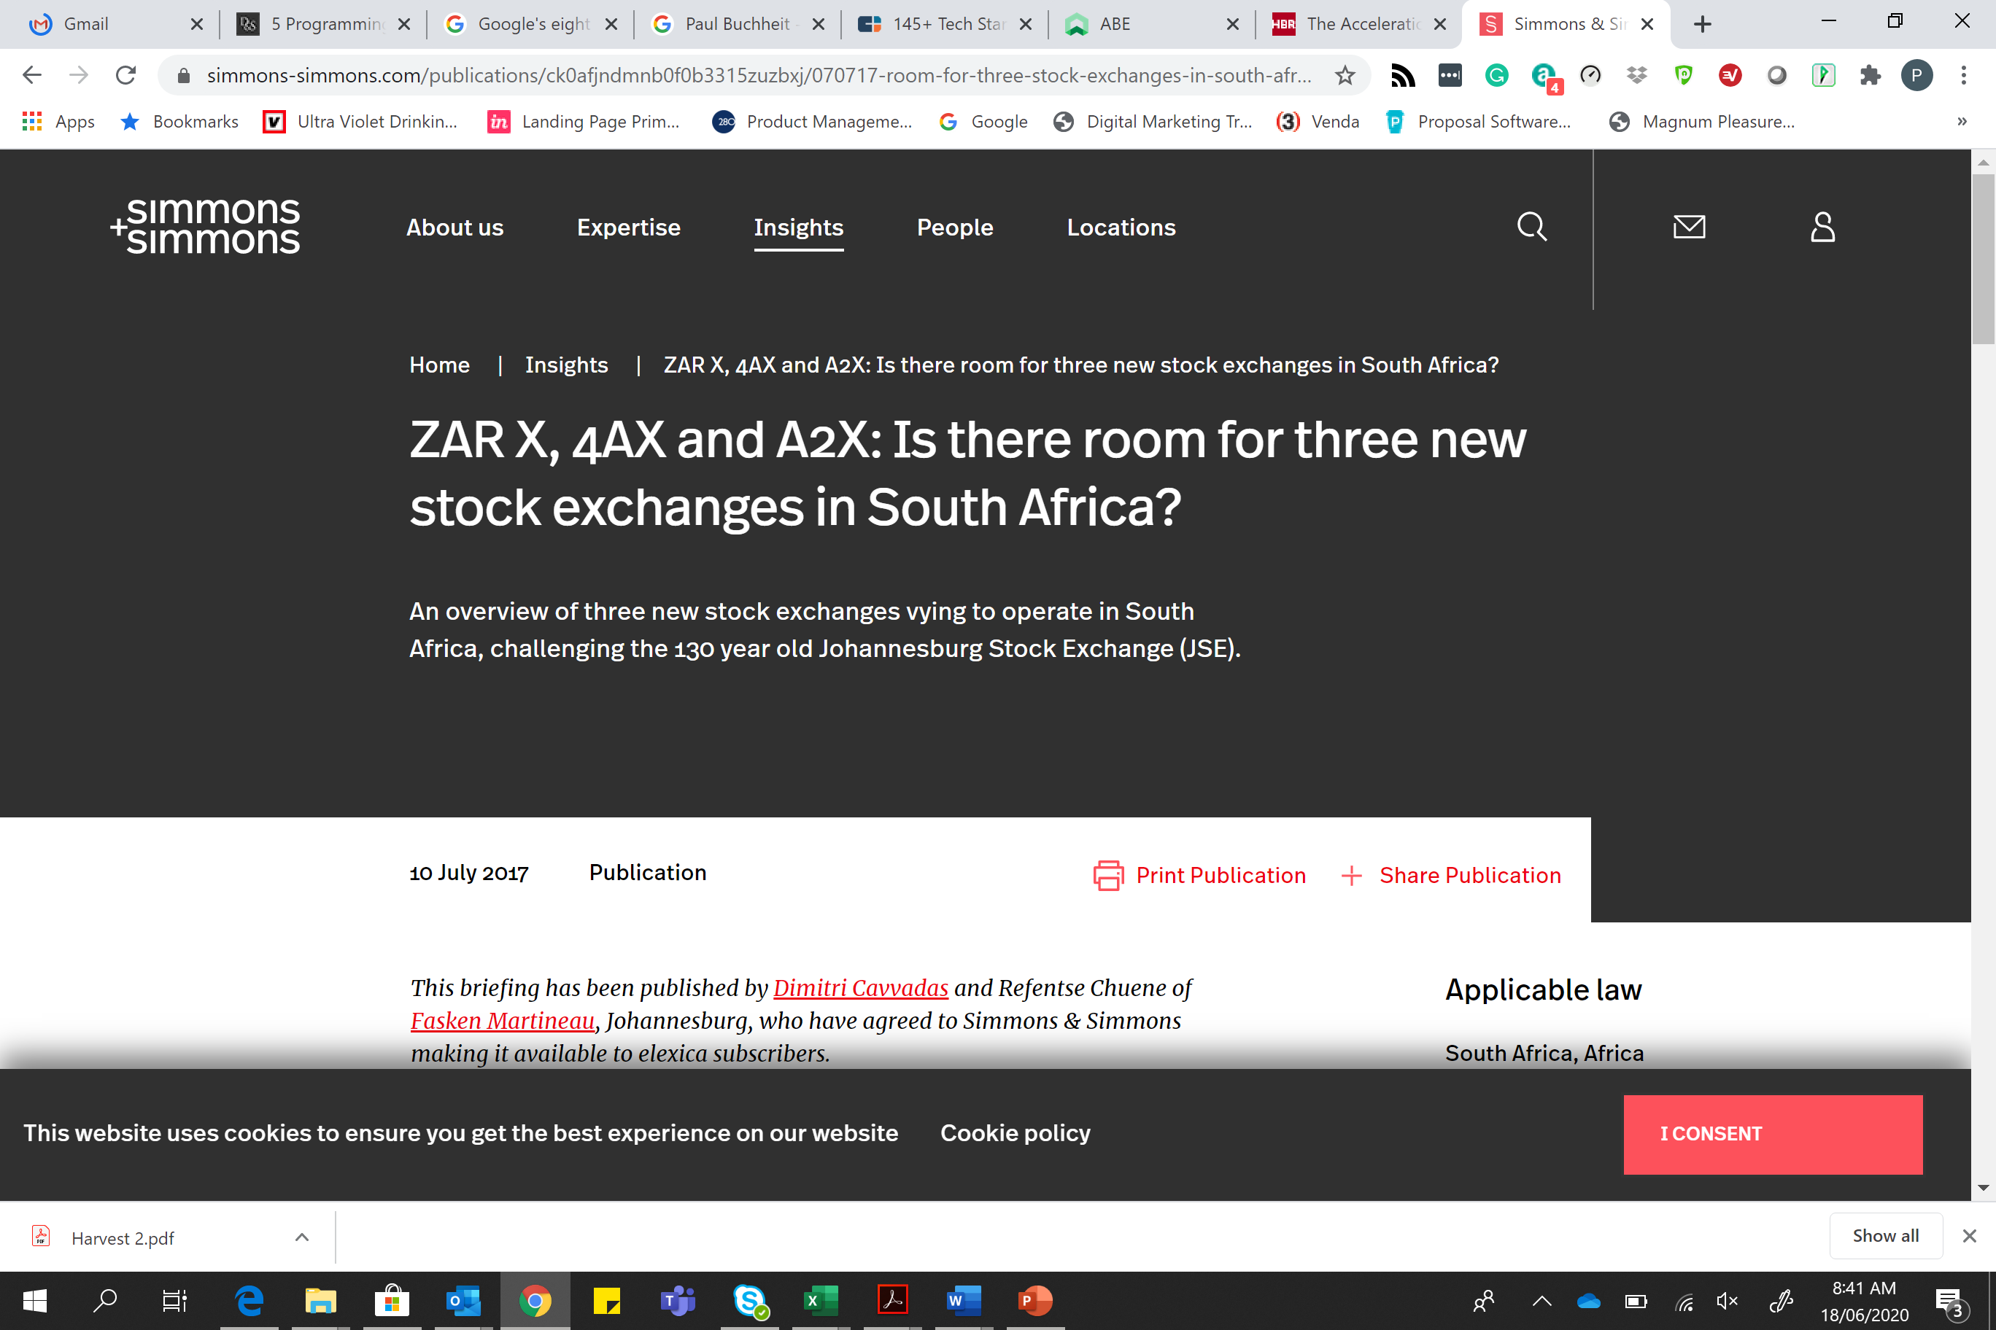















Tech trends ../3
AND ALL OF THIS IS HAPPENING SO MUCH FASTER THAN EVER BEFORE…
$19 BLN*
30 YEARS
$2 BLN
12 YEARS
$150 BLN^
$7 BLN
GBP 1 BLN^
7 YEARS
GBP 10 M
$8.4 BLN^
5 YEARS
$24 M
18 MONTHS
$17 BLN^
$3.7 BLN
WHAT ABOUT…?
www.abe.io

Slide 7
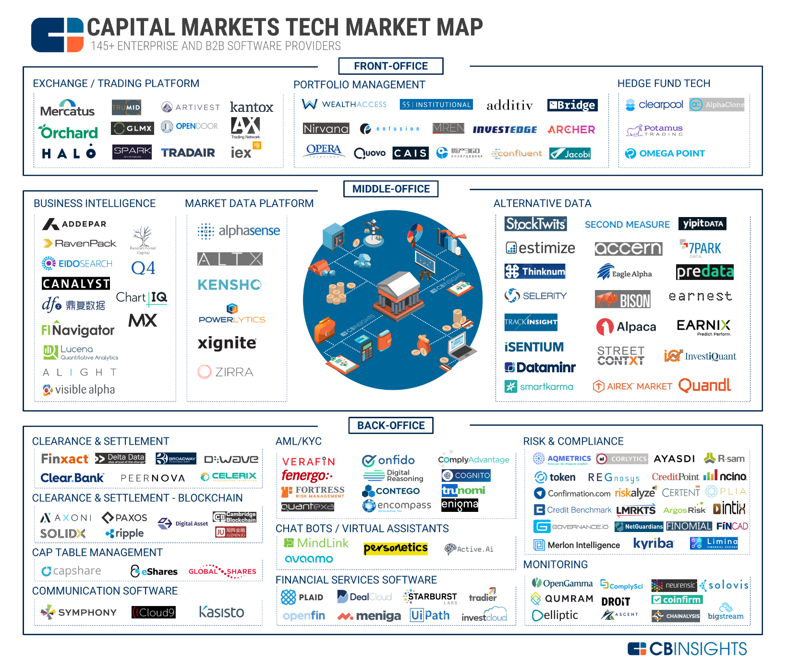
Tech trends ../4
Source: https://www.cbinsights.com/research/capital-markets-tech-market-map-fintech/

Slide 8
The Approach
TO UNDERSTAND OUR CURRENT STATE POSITION IN EACH OF THE AREAS ASSESSED, WE HAVE PROVIDED A HIGH-LEVEL OVERVIEW TO GUIDE THE CONVERSATION…
IT GOVERNANCE The extent to which the enterprise configures and operates its IT governance capabilities and how it allocates decision rights to empower its leadership and employees to make decisions on the use of information and technology.
TECHNOLOGY
How technologies and platforms are used to enable the business achieve its objectives
PEOPLE AND SKILLS
How the business identifies the roles, knowledge, skills and competencies needed in the IT workforce to minimize talent gaps and prioritise talent investments to fulfill future business needs
IT INFRASTRUCTURE
The effectiveness and efficiency of the organisation in leveraging composite hardware, software, network resources and services required for the management of the enterprise IT environment.
IT STRATEGY
The extent to which IT contributes to and develops strategy and associated strategic plans to achieve long-term objectives.
IT SECURITY
How the organisation put in place strategies that prevents unauthorized access to organizational assets such as computers, networks, and data.
BUSINESS INTELLIGENCE
The agility of the organisation in leveraging software and services to transform data into actionable insights that informs the organisation’s strategic and tactical business decisions
ENTERPRISE ARCHITECTURE
How the company helps to structure enterprise IT projects and policies to achieve desired business results and to stay on top of industry trends and disruptions using architecture principles and practices
DIGITAL READINESS
How prepared is the organisation's leadership and employees in adopting digital skills and their trust in technology as it may influence their use of digital tools

Slide 9
The Approach .../2
…AND TO ALSO HIGHLIGHT THE MATURITY STATE OF THE KEY COMPONENTS OF EACH OF OUR FOCUS AREAS
IT GOVERNANCE
IT SECURITY
IT INFRASTRUCTURE
IT STANDARDS AND CERTIFICATION
PROJECT MANAGEMENT
AVAILABILITY
CONFIGURATION MANAGEMENT
IT REGISTER
CAPACITY PLANNING
SERVICE MNAGEMENT
BUSINESS CONTINUITY MANAGEMENT
NETWORK SECURITY
CONFIDENTIALITY & PRIVACY
AVAILABILITY PLANNING
REDUNDANCY
VENDOR MANAGEMENT
AUTHENTICATION & AUTHORISATION
ACCOUNTABILITY & INTEGRITY OF INFORMATION
NETWORK DIAGRAM OF ALL IT SERVERS & SERVICES
ENTERPRISE ARCHITECTURE
BUSINESS INTELLIGENCE
NETWORK ARCHITECTURE
APPLICATION ARCHITECTURE
BUSINESS ANALYSIS
BUSINESS CONTINUTY MANAGEMENT
DATA WAREHOUSE
DATA STRUCTURE
DATA ANALYTICS
ROBOTICS & ARTIFICIAL INTELLIGENCE
TECHNOLOGY
IT STRATEGY
DIGITAL READINESS
AUTOMATION LEVEL
SOFTWARE DEVELOPMENT STACK
HIGH VELOCITY TRADING
STRATEGY EXECUTION
CULTURE
FUNDING
SOFTWARE DEVELOPMENT LIFECYCLE MATURITY
CONTROLS & SECURITY
TESTING
ALIGNMENT TO BUSNESS STRATEGY
DESIGN THINKING MODEL
CONTINUOUS INNOVATION
HIGH VELOCITY TRADING
IT STRATEGY DOCUMENTATION
PLATFORM FOR DIGITAL INNOVATION
PEOPLE AND SKILLS
HEAD COUNT
SKILL GAP ASSESSMENT
OPTIMUM STRUCTURE
INSOURCING vs OUTSOURCING
CURRENT FUCNTIONAL ORGANOGRAM REVIEW

Slide 10
Maturity Rating Definitions
Ad-hoc
LEVEL 1 – AD-HOC
There is evidence that the enterprise has recognised that the issues exist and need to be addressed. There are, however, no standardised processes; instead, there are ad hoc approaches that tend to be applied on an individual or case-by-case basis. The overall approach to management is disorganised
1
LEVEL 2 – REPEATABLE
Processes have developed to the stage where similar procedures are followed by different people undertaking the
same task. There is no formal training or communication of standard procedures, and responsibility is left to the individual. There is a high degree of reliance on the knowledge of individuals and, therefore, errors are likely.
Repeatable
2
LEVEL 3 – DEFINED
Procedures have been standardized and documented and communicated through training. It is mandated that these
processes should be followed; however, it is unlikely that deviations will be detected. The procedures themselves are not sophisticated but are the formalisation of existing practices
Defined
3
LEVEL 4 – MANAGED
Management monitors and measures compliance with procedures and takes action where processes appear not to be working effectively. Processes are under constant improvement and provide good practice. Automation and tools are used in a limited or fragmented way.
Managed
4
Optimised
LEVEL 5 – OPTIMISED
Processes have been refined to a level of good practice, based on the results of continuous improvement and maturity modelling with other enterprises. IT is used in an integrated way to automate the workflow, providing tools to improve quality and effectiveness, making the enterprise quick to adapt.
5

Slide 11
Current State Assessment
…AND TO ALSO HIGHLIGHT THE MATURITY STATE OF THE KEY COMPONENTS OF EACH OF OUR FOCUS AREAS
IT GOVERNANCE
IT SECURITY
IT INFRASTRUCTURE
IT STANDARDS AND CERTIFICATION
PROJECT MANAGEMENT
AVAILABILITY
CONFIGURATION MANAGEMENT
IT REGISTER
CAPACITY PLANNING
SERVICE MNAGEMENT
BUSINESS CONTINUITY MANAGEMENT
NETWORK SECURITY
CONFIDENTIALITY & PRIVACY
AVAILABILITY PLANNING
REDUNDANCY
VENDOR MANAGEMENT
AUTHENTICATION & AUTHORISATION
ACCOUNTABILITY & INTEGRITY OF INFORMATION
NETWORK DIAGRAM OF ALL IT SERVERS & SERVICES
ENTERPRISE ARCHITECTURE
BUSINESS INTELLIGENCE
NETWORK ARCHITECTURE
APPLICATION ARCHITECTURE
BUSINESS ANALYSIS
BUSINESS CONTINUTY MANAGEMENT
DATA WAREHOUSE
DATA STRUCTURE
DATA ANALYTICS
ROBOTICS & ARTIFICIAL INTELLIGENCE
TECHNOLOGY
IT STRATEGY
DIGITAL READINESS
AUTOMATION LEVEL
SOFTWARE DEVELOPMENT STACK
CODING STANDARDS
STRATEGY EXECUTION
CULTURE
FUNDING
SOFTWARE DEVELOPMENT LIFECYCLE MATURITY
CONTROLS & SECURITY
TESTING
ALIGNMENT TO BUSNESS STRATEGY
DESIGN THINKING MODEL
CONTINUOUS INNOVATION
HIGH VELOCITY TRADING
IT STRATEGY DOCUMENTATION
PLATFORM FOR DIGITAL INNOVATION
PEOPLE AND SKILLS
HEAD COUNT
SKILL GAP ASSESSMENT
OPTIMUM STRUCTURE
INSOURCING vs OUTSOURCING
CURRENT FUCNTIONAL ORGANOGRAM REVIEW

Slide 12
Summary of Components Maturity Rating
Maturity Rating | No. of Components
Ad-hoc | 6
Repeatable | 20
Defined | 13
Managed | 4
Optimised | 0

Slide 13






IT Governance
People and Skills
IT Strategy
Digital Readiness
Technology
Enterprise Architecture
IT Security
Business Intelligence
IT Infrastructure

Slide 14

IT Governance
The extent to which the enterprise configures and operates its IT governance capabilities and how it allocates decision rights to empower its leadership and employees to make decisions on the use of information and technology.
IT STANDARD AND CERTIFICATION
Recommendations
There are documented standards and processes such as SPPs, SLAs. We however need to implement relevant ISO standard and certifications such as:
ISO 9001:2015(Quality Management System)
ISO 27001:2013 (Information Security Management System)
ISO 22301:2019 ( Business Continuity Management)
ISO/IEC 27033-1:2015– Information technology Security techniques and Network security
REPEATABLE
Implement the relevant ISO Standard Certifications
Establish an IT Governance road Map and Plan for Long-term strategies
Re-evaluate IT Governance policies on a regular basis
Staff up the project governance group
Optimize the Service management capability
Implement Project Management Tool
PROJECT MANAGEMENT
No staff in the project / program management function to enhance effective project delivery and monitoring
There is need to clearly manage product ownership systems has largely affected implementation
Adherence to Product management governance approach
DEFINED
SERVICE MANAGEMENT
Help desk available to help drive the defined SPPs, SLAs, OLAs with respect to service management. However, this is far from optimised. The service request logging process on help desk needs to be optimised to help navigate service to the appropriate team as well manage issues around request duplication
DEFINED
BUSINESS CONTINUITY
KEY POINTS
Implementation of ISO 22301:2019 - Business continuity management systems. We require another alternate site in line with BCM ISO standard. Lack of auto failover and backup to disk process is a gap that requires urgent attention to ensure continuity in the event of any unforeseen failure
RELEVANT ISO CERITIFICATIONS (ISO 2017, 9001, 22301) etc
DEFINED
NEED FOR CLEARLY DEFINED BUSINESS OWNERSHIP
VENDOR MANAGEMENT
MANAGED
The vendor engagement process is well managed, However, in the area of application development, we need to come up with further benchmarks to ensure the vendors engaged have relevant experience.
IMPROVE SERVICE MANAGEMENT

Slide 15
IT Governance
People and Skills
IT Strategy
Digital Readiness
Technology
Enterprise Architecture
IT Security
Business Intelligence
IT Infrastructure

Slide 16
People and Skills
How the business identifies the roles, knowledge, skills and competencies needed in the IT workforce to minimize talent gaps and prioritise talent investments to fulfill future business needs
HEAD COUNT
Recommendations
We have 4 developers (3 staffs and 1 consultant) serving the entire group comprising of ( FMDQH, FMDQC, FMDQX, FMDQD). These developers handle development, support, analysis, Database management, testing) There is a need to have these clearly segmented or possibly implement a DeVops methodology.
IT infrastructure currently have 2 staff and 2 consultant serving the entire FMDQ Holdings. There is no dedicated end user support team making the enterprise team to also be involved with daily user support activities causing distraction
Skill Gap assessment
Adopt common programming languages for algorithmic trading (Java, C#, R and Python)
Training on latest trends and technologies
DevOps skills (Hybrid)
Implement Agile Software Development
Need for experienced technical / business analyst
Engage UI / UX experts
Need for experienced business analyst
Need for Quant Analyst
Engage Testing Experts
Basic Quant developer training for the developers
Cross learning with Collaboration with other exchanges (innovation Ecosystem)
Need for a Database for administrator
Engage an Enterprise Architecture
REPEATABLE
SKILL GAP ASSESSMENT
Full Stack developers with ASP, PHP, HTML and SQL skills
No dedicated Database administrator, application support team and dedicated QA/Testing team
Inadequate skill for application architecture and design
No dedicated 1st and 2nd Level Support Engineers
Developers still responsible for system analysis, database management
Lack of dedicated network security specialist
No dedicated UI/UX and Testing team
No dedicated technical / business analysts
DEFINED
OPTIMUM STRUCTURE
The present structure has a couple of issues, alongside security concerns, a case in point is developer access to the production systems ( Application and Databases). There is a need to had over production access which will include deployment, configuration, database management, support ) on the production bed to an independent team outside the development team.
KEY POINTS
AD-HOC
ADOPT MODERN PROGRAMMING LANGUAGES AND PRACTICES FOR ALGORITHMIC TRADING PLATFORMS
IMPLEMENT DevOps and AGILE SOFTWARE DEVELOPMENT
ASSESS, TRAIN AND RESOURCE

Slide 17
People and Skills
How the business identifies the roles, knowledge, skills and competencies needed in the IT workforce to minimize talent gaps and prioritise talent investments to fulfill future business needs
Recommendations
INSOURCING vs OUTSOURCING
Skill Gap assessment
Training on latest trends and technologies
DevOps skills (Hybrid)
Engage UX experts
Need for Quant Analyst
Basic Quant developer training for the and Services
Collaboration with other exchanges
Need for a Database for administrator
Need for experienced business analyst
AD-HOC
A policy review to support free lancers, contract , consultants with or without staff perks ( HMO, leave, housing, etc) outside the negotiated salary.
IT infrastructure currently have 2 staff and 2 consultant serving the entire FMDQ Holdings. There is no dedicated end user support team making the enterprise team to also be involved with daily user support activities causing distraction
CURRENT FUNCTIONAL ORGANOGRAM REVIEW
REPEATABLE
Current structure needs to be staff for effective management of the IT function to ensure effective management of the IT Franchise
KEY POINTS
IMPLEMENT ITIL - SOFTWARE DELIVERY LIFE CYLCE
TEAM FUNCTION SEGREGATION
INSOURCING & OUTSOURCING POLICY REVIEW

Slide 18
IT Governance
People and Skills
IT Strategy
Digital Readiness
Technology
Enterprise Architecture
IT Security
Business Intelligence
IT Infrastructure

Slide 19
IT Strategy
The extent to which IT contributes to and develops strategy and associated strategic plans to achieve long-term objectives.
IT STRATEGY DOCUMENTATION
Recommendations
Clearly documented Business Strategy implementation as it concerns IT
Cleary defined IT strategy as it concerns IT internal strategies with respect to optimum, service delivery and management
DEFINED
Implement Project Prioritisation Matrix
Conduct business Value realisation exercise
ALIGNMENT TO BUSINESS STRATEGY
DEFINED
Action based implementation plan of business strategy
Clearly defined timelines and defined responsibility of all parties
STRATEGY EXECUTION
Need to develop high-value capabilities and making investments that optimize value. This is to ensure long term and sustainable IT function.
REPEATABLE
KEY POINTS
AGREED IMPLEMENTATION PLAN ACROSS ALL TEAMS AND MONITORED BY A PROJECT MANAGEMENT TEAM
DEFINED BUSINESS STRATEGY WITH CLEARLY DEFINED IT RESPONSIBILTY
ADOPT PRIORITISATION MATRIX

Slide 20
IT Governance
People and Skills
IT Strategy
Digital Readiness
Technology
Enterprise Architecture
IT Security
Business Intelligence
IT Infrastructure

Slide 21
Digital Readiness
How prepared is the organisation's leadership and employees in adopting digital skills and their trust in technology as it may influence their use of digital tools.
CULTURE
Recommendations
Digitally led culture
Not afraid of making mistakes,
More collaboration and idea sharing
REPEATABLE
Create a digital culture by developing an ideation platform
Focus on process over technology
Centre digital transformation on the end users
Prioritise initiatives by return on investments
Conduct design thinking training Sessions
Conduct a Kaizen and Lean Six Sigma training
Set up a digital innovation lab
FUNDING
REPEATABLE
Need to fund research and digital lab
DESIGN THINKING MODEL
Embrace the Design thinking approach to problem solving – Empathize, Define, Ideate, Prototyping and Test
REPEATABLE
CONTINUOUS INNOVATION
No defined continuous innovation model.
Need to implement a Kaizen Model
REPEATABLE
PLATFORM FOR DIGITAL INNOVATION
KEY POINTS
No software-based ideas generation and collection tool. In the age of open innovation, this platform is a vital tool for helping organization to collect, manage, and track ideas or problem-solving strategies.
INNOVATION AND IDEA PLATFORM
AD-HOC
IMBIBE A DIGITAL READINESS CULTURE
COLABORATION AND PARTNERSHIP

Slide 22







THERE ARE SIX (6) “NO-REGRET” CAPABILITIES REQUIRED TO COMPETE IN NEXT FEW YEARS
SENSE & INTERPRET DISRUPTION
DEVELOP & LAUNCH NEW IDEAS FASTER
REORGANISE FOR SPEED
PARTNER & BUILD “CAMPS"
UNDERSTAND & LEVERAGE DATA
BUILD A HIGH DIGITAL QUOTIENT TEAM
Notes:
We believe that there are 6 no-regret capabilities required to compete in the next few years. And with any disruption new need to be able to:
You need sense change
Interpret it intelligently
Need to be able to respond
Sensing and interpreting disruption
This is a remarkably subtle thing and not very easy to do
Don’t just look in your backyard
There was a recent interview with the guys from Google regarding a book they just wrote. And one of the questions posed to Eric Schmidt was how is it that Google is so good at sensing and responding to the trends out there. Both of the guys looked at each other, smiled and said “we kinda of suck at it”. Over the last 15 years we missed Facebook, LinkedIn, Whatsapp and Twitter… If you combine those it’s a total market cap of 280 billion dollars and 2 billion active users. 30 times the music industry.
Ask which trends matter most – It’s more important to try understand which trends don’t matter
It’s knowing what doesn’t matter and what is distraction right now.
And try to understand the when
The biggest challenge is timing and whether you have the timing right
You need to know how much time you have to respond
Nobody answers the “when” question – The “when” is important. Think of the GPS manufacturers and Google. Do you think they anticipated that in 18 months that 85% of their market cap would vaporize?
Develop and Launch new ideas faster
Stop Innovating
We hear innovate so often. Perhaps a by product of solving customer problems.
Innovation sounds like a defensive stance where you have already lost
Whereas you should focus on the key problems your customers face that are close to your heart
Faster experiments
The idea of faster experiments is a cultural thing. Especially in environments that are risk averse and consumed by regulation. Coming up with and launching imperfect products is challenging
Michelin and Starbucks have established incubation hubs to purely focus on ideas that are on the fringe of their organization. Organisations are using these capabilities to test what works and what doesn’t work
Most of digital strategy is experimentation
Self-Disrupt
Slightly cheeky – but have seen organisations find entrepreneurs and give them the task of coming up with a business that could seriously hurt your business
This helps to unearth some deeply held/routed thinking, orthodox conventions and paradigms that we didn’t know we have, like “customers won’t pay for content”
Partnering and Building Camps
Is all about how well you respond
APIs
Most of us intuitively know and refer to ecosystems, etc. Digital leaders have an intrinsic understanding that they are not going it alone.
Partner for non-core
Are you creating an ecosystem connected to APIs that are as invested in your success as you are? – Expedia generates 90% of its revenue through APIs and partners
Telefonica is doing a phenomenal job with APIs working largest global brands and selling them non-sensitive data for geo-targeting
We mentioned that the Amazon are doing deal with USPS to deliver groceries to your door
Build Camps
Re-organise for speed
New Metrics
Financial metrics can be dangerous if they are premature
Traditional metrics do apply, but if you are building a mobile business there are 3 key metrics that apply:
Sessions per a Daily Active User: There is no better indication of how active your users are and how sticky they are then through this measure. If you’re at 3 you have a great thing going. If you have 5 you are Whatsapp
Retention:
D7, D30 and D90
Your retention on day 7, day 30 and day 90
This is one of the best indicators that as mobile property you will be around in a year from now
Usually 50% or higher than D90 means it’s a good venture
Number of active users as a percentage of your downloads
Downloads aren’t the problems. It’s active users.
In general, that ratio is 7 to 12 percent is great. The average is 9.
These are called traction metrics. These are power metrics not financially led. These are more important in the first 18 months.
New Structures
Create a new team away from the “mother ship” - Walmart have created a new team that build new business in new areas and are acquiring new customers. One of the most amazing digital ventures. Especially in the space of data and analytics
Garanti bank have created a spin-off – a new bank that removes the legacy
There are many models
Go Digitally Native
It’s personal, we have to hire those that have data and know what they are talking about
There is a scarcity of young people in the boardroom that know what they are talking about
Understand and Leverage Data
Create a dedicated analytics team
Volume + quality + different formats → Structure is more important than the amount or the size of the data
Start by asking the right questions – What would you do with the data? What are the problems you should be solving for? Don’t create propensity models for the sake of analytics
Build a High Digital Quotient Team
It’s not just about salary, but purpose
Identify the right acq-hire – look for talent both internally and externally
Increase digital EQ through bootcamps – We are in the process of creating a digital academy with Stanford that is more than just a digital Safari. It’s not just looking at the animals

Slide 23
IT Governance
People and Skills
IT Strategy
Digital Readiness
Technology
Enterprise Architecture
IT Security
Business Intelligence
IT Infrastructure

Slide 24
Technology
How technologies and platforms are used to enable the business achieve its objectives
AUTOMATION LEVEL
Recommendations
While we have a defined automation level, there is a need to review code reuse capability considering that most applications are in silos, There is a need to implement APIs, Micro services. This will help service reuse made possible by the provided APIs
DEFINED
Train the developer in secure coding
Adopt trading platform software development stack
Support Service Oriented Architecture
Adopt Product owner engagement to requirement elucidation and approval
SOFTWARE DEVELOPMENT LIFECYCLE MATURITY
We have a clearly defined SDLC process however, the following threaten the efficiency of this process.
Lack of proper project ownership
Proper project management
Lack of all complimentary roles of testing and thorough business analysis
DEFINED
SOFTWARE DEVELOPMENT STACK
DEFINED
There is a need to review our software development stack, particularly around programming languages used in the development. Most developers of security trading platforms favour the use of C, C++, Java, Python, R and C#. Aligning to these standards makes it easy to get support and knowledge transfer
CODING STANDARDS
KEY POINTS
Implementation of secure coding standards
Designing and development for lightweight applications, highly scalable, fault tolerant , heath checks
SERVICE RE-USEABLE (APIs and Micro service)
DEFINED
ENHANCED IT INFRASTURCTURE DEPLOYED AS A CODE
APPLICATION MONITORING

Slide 25
Technology
How technologies and platforms are used to enable the business achieve its objectives
CONTROLS AND SECURITY
Recommendations
Need for adherence to the following:
Web Application Security Project (OWASP) top 10 standards
Inhouse controls and security standards definition and adherence
Secure coding
Pen and security testing ( DAST (dynamic application security testing) and SAST ( static application security testing)
Define Minimum testing criteria for application acceptance for production
Defined Application Certification Process to include VAPT and other Functional and Non-functional Testing
Implement cloud native development to remain extremely lightweight nimble, scalable and cost efficient
REPEATABLE
TESTING
REPEATABLE
Only User Acceptance Test (UAT) is defined as a criteria for solution acceptance
Other form of testing are not currently done for applications being deployed into production
HIGH VELOCITY TRADING
AD-HOC
Existing trading platforms need to rebuilt with the following considerations:
Lightweight service implementation
Deployment of infrastructure as code to help auto scaling
Fault tolerant systems
Load tested and benchmarked
Enhanced Security focus
High availability
KEY POINTS
APPLICATION CERTIFICATION
ENHANCE TESTING PROCESS
SECURE SYSTEM WITH HIGH AVAILABILITY

Slide 26
IT Governance
People and Skills
IT Strategy
Digital Readiness
Technology
Enterprise Architecture
IT Security
Business Intelligence
IT Infrastructure

Slide 27
Enterprise Architecture
How the company helps to structure enterprise IT projects and policies to achieve desired business results and to stay on top of industry trends and disruptions using architecture principles and practices
NETWORK ARCHITECTURE
Recommendations
Network access control available but not optimized
High availability on all network infrastructure. Implement upgrades when necessary
Product owner to interphase with IT
IT business interface resource
Follow Architecture governance / design process
Build Mock-Ups and Prototypes for planned solutions
Enhance Network Access control
Project Management approach to allow for Analysis and solution architecture design
MANAGED
APPLICATION ARCHITECTURE
REPEATABLE
Current application landscape not scalable and futuristic
Application landscape not defined in relation to business strategy
Most application are siloed and monolithic
Applications are not lightweight and fault tolerant
Application stack does not have load balancing
BUSINESS ANALYSIS
REPEATABLE
Solutions are defined with only high-level business requirement
No business analyst to translate business requests into technical requests
No dedicated technical design team to evaluate design consideration and implication of the design
Changing requirement and business needs
Undocumented requirements
KEY POINTS
BUSINESS CONTINUITY MANAGEMENT
NEED FOR APPLICATION ARCHITECTURE DESIGN AND GOVERNANCE
MANAGED
Application versioning consistency
Parameterised configuration parameters
Back and restore of critical applications need to be more structured
PARAMETERISED CONFIGURATION ( TO ENABLE DYNAMIC CONFIGURATION MANAGEMENT)
PROTPTYPING AND MOCK-UPs

Slide 28
IT Governance
People and Skills
IT Strategy
Digital Readiness
Technology
Enterprise Architecture
IT Security
Business Intelligence
IT Infrastructure

Slide 29
IT Security
How the organisation put in place strategies that prevents unauthorized access to organizational assets such as computers, networks, and data.
AVAILABILITY
Recommendations
The current infrastructure is designed for high availability (systems that are durable and likely to operate continuously without failure for a long time) with accommodations for failure in the form of redundant components. However, there are some infrastructure that are not configured for high availability with provision of redundant component.
DEFINED
Implement configuration management tool
Implement two factor authentication (2FA)
Establish a strong password policy
Implement privileged access management
Create Culture of Security Awareness
Implement patch and vulnerability assessment
ACCOUNTABILITY & INTEGRITY OF INFORMATION
Need to improve authentication, authorisation, and accounting (AAA) framework for intelligently controlling access to computer resources, enforcing policies, auditing usage, and providing the information necessary to bill for services.
REPEATABLE
CONFIGURATION MANAGEMENT
Need to establish and maintain consistency of a product's performance, and its functional and physical attributes with its requirements, design, and operational information throughout its life
REPEATABLE
KEY POINTS
IMPROVE SYSTEM CONFIGURATION MANAGEMENT
MONITOR THREAT AND UPDATE PATCHES
AUTHENTICATION AUTROISATION AND ACCOUNTING

Slide 30
IT Security ../2
How the organisation put in place strategies that prevents unauthorized access to organizational assets such as computers, networks, and data.
NETWORK SECURITY
Recommendations
REPEATABLE
Need to implement of ISO/IEC 27033-1:2015 (Information technology Security techniques and Network security). This standard defines and describes the concepts associated with, and provides management guidance on, network security.
Implement two factor authentication (2FA)
Establish a strong password policy
Implement privileged access management
Create Culture of Security Awareness
Implement patch and vulnerability assessment
Manage Privilege Account
CONFIDENTIALITY AND PRIVACY
DEFINED
Deployment of PII on all systems to secure/protect personal identification information of the organisation still pending
AUTHENTICATION AND AUTHORISATION
REPEATABLE
Authentication and authorisation available without 2FA
Network access control to be implemented
SPP to be developed
KEY POINTS
MANAGE PRIVILEDGE ACCOUNT
REGULAR IT SECURITY POLICY REVIEW
IMPLEMENT ISO / IEC 27033-1:2015

Slide 31
IT Governance
People and Skills
IT Strategy
Digital Readiness
Technology
Enterprise Architecture
Security
Business Intelligence
IT Infrastructure

Slide 32
Business Intelligence
The agility of the organisation in leveraging software and services to transform data into actionable insights that informs the organisation’s strategic and tactical business decisions.
DATA WAREHOUSE
Recommendations
REPEATABLE
Lack of Enterprise Data Warehouse
Data based decision marking
Establish Data structure (part of architecture project)
Encourage Actionable insights
Drives collaboration
DATA STRUCTURE
MANAGED
There are no clearly defined data structures (i.e. SQL, JSON, XML)
DATA ANALYTICS
AD-HOC
Given that there is no data warehouse in place, data analytics cannot be performed which would aid business intelligence
ROBOTICS AND ARTIFICIAL INTELLIGENCE
AD-HOC
Minimal intelligent automation system that will enable automation of repetitive processes
KEY POINTS
EHANCED APPLICATION ARCHITECTURE
DATAWARE HOUSE , BUSINESS INTELLIGENCE IMPLEMENTATION
IMPLEMENT ROBOTIC PROCESS AUTOMATION

Slide 33
IT Governance
People and Skills
IT Strategy
Digital Readiness
Technology
Enterprise Architecture
Security
Business Intelligence
IT Infrastructure

Slide 34
IT Infrastructure
The effectiveness and efficiency of the organisation in leveraging composite hardware, software, network resources and services required for the management of the enterprise IT environment.
IT REGISTER
Recommendations
Register of suppliers of infrastructure including maintenance and support is well maintained.
Implement Cloud & serverless functions infrastructure
Update Network architecture design
Implement capacity planning solution to provide data-driven justification for IT investments
DEFINED
CAPACITY PLANNING
Capacity planning defines the process by which an organization can establish current and future processing needs. We need to improve capability in the compute infrastructure as the important thing about capacity planning is that infrastructure is flexible to meet changing demands.
REPEATABLE
AVAILABILITY PLANNING
Lack of availability of busines requirement projection in as it relates of compute, network and storage requirement to ensure that existing and future availability requirements for Information Technology (IT) Services can be provided using effective cost measures
REPEATABLE
REDUNDANCY
Redundancy currently exist but not across all IT infrastructure.
KEY POINTS
REPEATABLE
CONDUCT CAPACITY AND AVAILABILITY PLANNING
NETWORK DIAGRAM OF ALL IT SERVERS & SERVICES
IMPLEMENT PUBLIC CLOUD
DEFINED
Network diagram of all IT infrastructure to be redefined in line with the Private /Public cloud implementation initiative
UPDATE NETWORK DIAGRAM

Slide 35
Summary of gap assessment findings
Below is summary of the high level gaps which exists in each of the key areas of focus according to Gartner’s IT Score for CIO.
IT Governance
People and Skills
IT Strategy
IT governance framework is not focused on balancing risk and reward
There is no defined ad-hoc IT risk discipline
IT decision rights is not focused on managing IT risk
Lack of defined skills and competency development plans
No application of consistent framework to talent sourcing decisions
There is no defined career path information for employees
IT has limited influence in front-office business decisions
Minimal contributions from IT in designing digital business models focused on growth
Lack of standardized strategy communication practices
Digital Readiness
Technology
The digital enablement strategy
Imbibe the culture of Innovation
Disruption and designing thinking
Think E
There is no defined technology roadmap in place to support business objectives
Lack of defined technology standards
IT applications are not optimally utilized to aid flexibility and scalability

Slide 36
Summary of gap assessment findings ../2
Enterprise Architecture
IT Security
Enterprise architecture implementation
Software layer
Application layer
Data layer
Framework for scalability, Business Continuity, High Availability
Software layer ( Application security, via up to date secure coding practices)
Business Intelligence
Infrastructure
Business intelligence implementation
Implementation of infrastructure as code ( containerisation, orchestration)

Slide 37
Questions CSA Should Answer
1. Services, Functions and Process
2. Governance
3. Architecture & Technology
How efficiently and effectively does the IT Organisation go about delivering its services?
Are IT Services being delivered in line with business priorities?
Are adequate confidentiality, integrity and availability controls in place for IT security?
How effectively are decisions being made and enforced within the IT Organisation
Are IT risks understood and being managed within the enterprise risk appetite?
Is appropriate governance in place to ensure new projects are likely to be delivered on time and within budget?
Is there a suitable architecture roadmap defined?
Does the IT Organisation have the required tools and technology to deliver and govern IT Services effectively?
What opportunities exist to simplify and standardize the IT and Business technology landscape?
Is the workforce able to use the IT systems productively and safely?
Is the quality of IT systems appropriate for business needs?
4. Perception
5.Strategy and Business Alignment
6. Cost and Financial Management
What is the perception of the IT organisation and services delivered from an IT and Business perceptive?
How does measured performance compare to business perception?
Are IT and the business strategy aligned with the most strategic business needs?
Are IT investments aligned with the most strategic?
How well is the IT organisation aligned to business objectives and changes in the IT marketplace?
Is IT cost optimized?
Does the IT organisation have the required cost visibility? If not, why?
How can IT costs be driven down without sacrificing quality and stability?
How does the TCO and spend profile of the IT organisation compare to peer organisations?

Slide 38
Questions CSA Should Answer ../2
7. Sourcing
8.Performance Management
9. People and Skills
How effective is the current sourcing strategy in supporting the IT organisation’s strategy?
What sourcing and location configuration models might be best suited for the IT organisation’s objectives?
How effective is the IT department at measuring its processes, capabilities and service fulfilment?
Is IT’s performance measured to detect problems before its is too late?
Can IT performance be linked back to business goals?
What areas of improvement exist across the organisation structure? How does the IT organisation compare to peers in terms of structure and headcount?
What organisation structure would be most beneficial to the IT organisation’s ability to deliver value?
Is the organisation achieving optimum use of its resources?

Slide 39
Future State: High-Level Transformation Journey
Months 0-18
Months 19 - 30
Phase 1
Establish Digital Foundation
Phase 2
Build Digital-Enabling Structures
Includes YoY Initiatives running through 2023
Months 31 - 42
Phase 3
Innovate & Optimise Digital Capability
Program and Digital Change Management
Kick-off
2020 - 2021
Check Point 1
2022
Check Point 2
2023
Check Point 3
Technology/Digital Transformation
Phase 1: “Establish Foundation” addresses foundational issues which when resolved, will introduce stability, reliability and set the baseline for building enabling structures and transforming FMDQ.
Phase 2 : “Build Enabling Structures” which entail design, development and implementation of supportive systems, processes and technology across FMDQ.
Phase 3: “Innovate & Optimise Capability” the focus will shift to digital innovation and disruptive initiatives that will differentiate FMDQ
A Program and Change Management function is required to coordinate the execution of projects activities, ensure ownership and buy-in at all levels, determine the overall performance of the projects and report same to the Group’s Executive Committee.

Slide 40
IT Governance
People and Skills
IT Strategy
Digital Readiness
Technology
Enterprise Architecture
IT Security
Business Intelligence
IT Infrastructure

Slide 41
Future State: Target Technology Roadmap
2020- 2021
2022
Establish Foundation
Build enabling Structures
Innovate & Optimize
2023+
Target technology Roadmap
Application Rationalisation
Implement Application Monitoring Solution
Trading System Redevelopment
HR Automation
Continuous initiative
Deploy Enterprise Testing tool
Digital Solutions
Document Management System
Implement ERM solution
Develop & Sensitize Ideation Hub
Enterprise Data Warehouse
Continuous initiatives
Intelligent Automation
Implement ERP Solution
Implement Cloud services
Process optimisation
Implement Digital SOC
Shared Service Infrastructure architecture
Implement Enterprise Architecture
Upgrade Infrastructure Monitoring system
Implement High Availability
AAA Configuration
Conduct Application Documentation
Network Access Control
Digital Enablers
Implement SDLC Process
Infrastructure/Technology refresh
Security Transformation
Workforce. Transformation
Data Center Co-location
Deploy Enterprise testing tool
Define cybersecurity strategy
Implement Fortinet ADC
PII Implementation
Digital Enablers
Technology Infrastructure
Digital Channels
Security

Slide 42
Document Management System
Key Indicators
Business criticality & importance | Medium
Benefits | High
Cost of initiative | Low
Technical complexity & risk | Low
Impact of change on business | Medium
Initiative Objective
Reduce lost and misfiled documents. Provide faster search and retrieval of documents. Reduce the amount of physical space used to store documents, such as file cabinets, boxes and shelving. Better organize existing documents.
Benefits / Value
Reduced Storage Space. Enhanced Security. Improved Regulatory Compliance. Easier Retrieval. Better Collaboration. Better Backup and Disaster Recovery.
Approach
Determine Who Will Take Charge Assess the Current Filing System and Determine Strategy Requirements Identify Each Document Establish Procedures and Requirements, Then Document Preparing the Strategy Purge Unnecessary Documents Organize Documents and Maintain the Process
Dependencies | Timeline
Not Applicable | xx months
Sourcing | Budget
Off the self | $TBD
Initiative Owners
Business Sponsor
Co-sponsor
Initiative Lead

Slide 43
IT Governance
People and Skills
IT Strategy
Digital Readiness
Technology
Enterprise Architecture
IT Security
Business Intelligence
IT Infrastructure

Slide 44
Workforce Transformation
Key Indicators
Business criticality & importance | Medium
Benefits | High
Cost of initiative | Low
Technical complexity & risk | Low
Impact of change on business | Medium
Initiative Objective
Develop a “digital workforce” and imbibe the culture of digital throughout the group via continuous training and retraining of our people in adopting new technologies and innovative ways of doing things Empower Workforce with digital tools and capacity building opportunities Users are able to work and collaborate from different location with deferent devices and stay productive
Benefits / Value
Workforce upskilling and productivity Increased employee satisfaction Improved brand perception
Approach
Create a change management programme to drive consistent transformation communications Create internal programmes and people engagement activities that empower employees to experiment with and market new concepts Phase II Execution of yearly training plan
Dependencies | Timeline
Not Applicable | Phase I – xx months Phase II – Continuous
Sourcing | Budget
Professional Services Provider | Phase I - $TBD Phase II – $TBD
Initiative Owners
Business Sponsor
Co-sponsor
Initiative Lead

Slide 45
Workforce Transformation ../2
FMDQ Group
Chief Executive Officer
iQx Consult Limited
Board of Directors
Ag. Managing Director
Project Monitoring
Cyber Security
Product Engineering
IT Operations
Enterprise Management
Applications Development
Applications Management
Enterprise Architecture
Infrastructure Design
Infrastructure Management
Business Interface
Quality Assurance
Service Management
Digital Innovation
Process Automation
Data Engineering
Outsourced Functions
Legal & Company Secretariat
Strategy
Finance Services
Internal Audit
General Internal Services
Human Resources
Marketing Communications
Internal Control
Enterprise Risk Management

Slide 46
Workforce Transformation ../3
FMDQ Group
Chief Executive Officer
iQx Consult Limited
Board of Directors
Application
Database
Infrastructure
Ag. Managing Director
Leke Adekoya
Program Management
Budget Management
PMO
Cyber Security
Digital Product
IT Project Delivery
Product Sales
Product Management
Product Analyst
Product Engineering
IT Operations
Enterprise Management
Applications Development
Full Stack Development
UI / UX Designer
Front End Development
Applications Management
1st level Support
Help Desk
2nd level
Support Engineer
Enterprise Architecture
Enterprise Architecture
IT Strategy & Planning
IT Policies & Governance
Quality Assurance
Software QA
Product Certification
Security Testing
Service Management
Availability Management
Change Management
Release Management
Business Interface
Business Analysis
Quant Analysis
Technical Analysis
Infrastructure Design
Cloud Infrastructure
Hardware Management
Private Cloud Management
Network / Security
Process Automation
Workflow Automation
Process improvement
Data Engineering
MIS
Big Data Analysis Database Administration
Digital Innovation
Rapid Prototyping / Minimum
Viable Products
Partnerships / Alliances
Robotics
Digital Lab
Infrastructure
Management
Hardware Support
User Devices Support -
Laptops, Printers, Projectors etc

Slide 47
Ideation Hub
Key Indicators
Business criticality & importance | Low
Benefits | High
Cost of initiative | Low
Technical complexity & risk | Medium
Impact of change on business | Low
Initiative Objective
Develop an innovation/ideation lab and encourage adoption of portal for sharing ideas group-wide as well as rapid experimenting and prototyping the use case
Benefits / Value
The designed hub acts an accelerant for technology innovation Fosters innovation and creativity aimed at supporting FMDQ’s long term goals and objectives Creates an environment and methodology to prove out a concept before investing too many resources Develop ability to demonstrate ROI & Value on new ideas and concepts Improves ability to attract and retain technical talent
Approach
Define vision and goals for the innovation lab Design the innovation space as defined by the qualified innovation labs consultants Deploy a software-based ideation tool organisation wide to enable idea visibility and encourage creativity in personnel (e.g. Cognistreamer) Recruit and onboard technical skills per the defined innovation and skills area Build and launch the dedicated physical ideation hub (preferably within the Exchange Place)
Dependencies | Timeline
N/A | TBD
Sourcing | Budget
In-house Professional services firm / Innovation Lab providers | TBD
Initiative Owners
Business Sponsor
Co-sponsor
Initiative Lead

Slide 48
IT Governance
People and Skills
IT Strategy
Digital Readiness
Technology
Enterprise Architecture
IT Security
Business Intelligence
IT Infrastructure

Slide 49
Define Cybersecurity Strategy & Framework
Key Indicators
Business criticality & importance | High
Benefits | High
Cost of initiative | Low
Technical complexity & risk | Low
Impact of change on business | Medium
Initiative Objective
Define and document the cybersecurity strategy and establish security architecture for the group in alignment with business objectives
Benefits / Value
Defines framework to ensure that cyber security incidents do not result in significant disruption to normal operations Improved information security and business continuity management Improved customer trust and stakeholder confidence in light of rising cybercrimes
Approach
Conduct Cyber Security Assessment and identify gaps Define Enterprise Security Architecture Develop target state and recommendations, including remediation approaches, project prioritization and implementation roadmaps Develop and roll-out Information Security Awareness training program across the enterprise Establish formal enterprise-wide information security training and awareness program
Dependencies | Timeline
N/A | 3 months
Sourcing | Budget
In-house/Professional Services Firm | $50k - $70k
Initiative Owners
Business Sponsor
Co-sponsor
Initiative Lead

Slide 50
IT Governance
People and Skills
IT Strategy
Digital Readiness
Technology
Enterprise Architecture
IT Security
Business Intelligence
IT Infrastructure

Slide 51
Enterprise Data warehouse (EDW)
Key Indicators
Business criticality & importance | Medium
Benefits | High
Cost of initiative | High
Technical complexity & risk | Low
Impact of change on business | Medium
Initiative Objective
Build and implement enterprise data-warehouse solution to serve as the central repository for all data sources
Benefits / Value
Information is consolidated and will serve as a single source of truth, thus significantly reducing data inconsistency, redundancy, quality issues Enhanced decision making due to improved data availability and accessibility
Approach
Define EDW architecture Agree on functional and technical design for EDW Carry out data cleansing and harmonisation across existing data sources/data marts Build (customize), test and deploy a robust Data Warehouse solution Sustain and optimize EDW
Dependencies | Timeline
Application Rationalisation | TBD
Sourcing | Budget
In-House/Solution Vendor (e.g. Microsoft, Oracle, Teradata etc.) | TBD
Initiative Owners
Business Sponsor
Co-sponsor
Initiative Lead

Slide 52
HR Automation
Key Indicators
Business criticality & importance | Medium
Benefits | High
Cost of initiative | High
Technical complexity & risk | Low
Impact of change on business | Medium
Initiative Objective
Build and deploy an HR automation system to eliminate manual processes involved in carrying out HR activities such as requesting leave, etc.
Benefits / Value
Reduced HR budgeting or HR Staffing Subpar recruitment and staff onboarding. Timesheet management Enhanced staff appraisal process Enhanced leave management process
Approach
Define business requirements Conduct vendor selection Review/validate processes to be automated Build, test and train End Users and IT on the solution Deploy solution Sustain and optimise the solution
Dependencies | Timeline
Data cleansing Application Rationalisation | TBD
Sourcing | Budget
In-House/Solution Vendor (e.g. Microsoft, Oracle, Teradata etc.) | TBD
Initiative Owners
Business Sponsor
Co-sponsor
Initiative Lead

Slide 53
ERP Implementation
Key Indicators
Business criticality & importance | Medium
Benefits | Medium
Cost of initiative | High
Technical complexity & risk | Medium
Impact of change on business | Medium
Initiative Objective
Implement a robust ERP solution to consolidate and automate core back-office functions and processes (Finance, HCM, Procurement etc.)
Benefits / Value
Significant productivity savings and increased back-office efficiency Improved operational excellence and competitive advantage Cost savings from back office application consolidation Improved workflow and document management capability
Approach
Define business requirements for ERP solution modules Conduct vendor selection for ERP solution and system integrator Review/validate processes to be automated by ERP (Financial Management, Human Capital Management, Procurement, Administration, Facility / Inventory Management etc.) Build, test and train End Users and IT on the solution Deploy ERP solution Sustain and optimise ERP solution
Dependencies | Timeline
Process optimisation Application Rationalization | TBD
Sourcing | Budget
Solution vendor (Microsoft, Oracle, SAGE etc.) | TBD
Initiative Owners
Business Sponsor
Co-sponsor
Initiative Lead

Slide 54
IT Governance
People and Skills
IT Strategy
Digital Readiness
Technology
Enterprise Architecture
IT Security
Business Intelligence
IT Infrastructure

Slide 55
Implement SDLC Process
Key Indicators
Business criticality & importance | High
Benefits | High
Cost of initiative | Low
Technical complexity & risk | Low
Impact of change on business | Medium
Initiative Objective
Define a solution delivery framework using sound project management and SDLC principles to deliver the capabilities required to clearly define, estimate, cost and manage deployment of solutions
Benefits / Value
Delivery of solutions within defined scope, time and budget Enhanced customers’ experience through Improved quality solutions Increased return on investments made on implemented new initiatives Enhanced development speed which improves time to market of new solutions
Approach
Reference the documented SDLC process for guidance in implementation of the process Assess the current implementation processes to identify gaps Introduce absent sub IT Units required to close identified gaps Define the templates and guidelines for the different phases of the framework Drive operationalisation of the new delivery framework using best practice standards e.g. Agile, Scrum Methodology
Dependencies | Timeline
Not Applicable | 3 months
Sourcing | Budget
In-house | N/A
Initiative Owners
Business Sponsor
Co-sponsor
Initiative Lead

Slide 56
Cloud Adoption
Key Indicators
Business criticality & importance | Medium
Benefits | High
Cost of initiative | Medium
Technical complexity & risk | Low
Impact of change on business | Medium
Initiative Objective
Cloud adoption will improve collaboration, data availability, flexibility, greater business agility and cost savings.
Benefits / Value
Eliminates IT CAPEX for layout and infrastructure and reduces IT OPEX for personnel and infrastructure maintenance Improves IT budget utilisation and operational efficiency Improves IT’s ability to respond to business demands Mitigates risks associated with security and disasters
Approach
Conduct cloud assessment exercise to identify potential applications, infrastructure systems or services to be moved to the cloud Deploy target systems to cloud-ready technologies Conduct vendor selection in line with the defined business/technical requirements for cloud solutions Work with preferred OEMs and cloud service provider to migrate systems and data to cloud infrastructure Decommission devices/hardware previously housing migrated services that have reached EOL
Dependencies | Timeline
Application rationalisation Storage & capacity planning | TBD
Sourcing | Budget
Solution Vendor (Microsoft Azure, Amazon AWS) | TBD
Initiative Owners
Business Sponsor
Co-sponsor
Initiative Lead

Slide 57
IT Governance
People and Skills
IT Strategy
Digital Readiness
Technology
Enterprise Architecture
IT Security
Business Intelligence
IT Infrastructure

Slide 58
Deploy Enterprise Testing Tool
Key Indicators
Business criticality & importance | Medium
Benefits | Medium
Cost of initiative | Low
Technical complexity & risk | Low
Impact of change on business | Medium
Initiative Objective
Enterprise testing tool, to help ensure that applications have tests ( Stress , Penetration, Load) run on them before going to production. This will provide benchmarks that will help define system expectations with respect to what type, kind of infrastructure needs to provided to efficiently serve our customer base
Benefits / Value
Ensure deployed application are stabled in production Help reduce re-work due to previously undetected coding error
Approach
Conduct all relevant Functional and Non-functional tests using automated testing tools
Dependencies | Timeline
Not Applicable | Q3 2020
Sourcing | Budget
Vendor Sourcing | TBD
Initiative Owners
Business Sponsor
Co-sponsor
Initiative Lead

Slide 59
Application Rationalisation
Key Indicators
Business criticality & importance | Medium
Benefits | Medium
Cost of initiative | Low
Technical complexity & risk | Low
Impact of change on business | Medium
Initiative Objective
Rationalise and consolidate business and IT applications to simplify the application landscape and minimise duplication of application functionality and diversity of technologies and software vendors
Benefits / Value
Help declutter the application landscape for effective monitoring and performance Better IT Budget Utilisation Economies of scale from reduced number of IT applications and better cost negotiation for future IT spend Prevents duplicate investment of time, infrastructure and space Reduced number of point-to-point integrations and manual workarounds between applications Optimised software management process
Approach
Review application landscape and identify inadequate/duplicate applications to be decommissioned/consolidated Develop strategy for decommissioning applications Migrate data from all applications that are due for decommissioning Decommission applications Rationalise future applications based on Target State Architecture requirements
Dependencies | Timeline
Not Applicable | 12- 8 months
Sourcing | Budget
In-house / Vendor | Not Applicable
Initiative Owners
Business Sponsor
Co-sponsor
Initiative Lead

Slide 60
Trading Systems Re-development Initiatives
Key Indicators
Business criticality & importance | Medium
Benefits | Medium
Cost of initiative | Low
Technical complexity & risk | Low
Impact of change on business | Medium
Initiative Objective
A multi-asset class proprietary trading system that allow market participants to trade multiple assets types in very easy and efficient way. These includes redevelopment of Q-Deal, PenDealer and FFTRS and FMDQ-Next Trading Platform enhancement
Benefits / Value
A reliable and robust multi-asset trading system for small venues Ability to facilitate spin-off of new venues as product innovation takes place.
Approach
Collaboration with leading industry players like Exactpro and RemoraTech, in other to leverage their experiences in these key areas
Dependencies | Timeline
Not Applicable | Q4 2020
Sourcing | Budget
In-house | N100m
Initiative Owners
Business Sponsor
Co-sponsor
Initiative Lead

Slide 61
Applications Documentation
Key Indicators
Business criticality & importance | Medium
Benefits | Medium
Cost of initiative | Low
Technical complexity & risk | Low
Impact of change on business | Medium
Initiative Objective
Document application, providing data dictionaries, process flows, architectural diagram, so as to aid know how on the applications, ease support and maintenance burdens.
Benefits / Value
Knowledge transfer Informed Maintenance Service Support Proper and clear error reporting
Approach
Application development based strictly on approved BRD Application code documentation during development Process documentation (Application installation/rollback process) Maintenance of error and resolution dictionary
Dependencies | Timeline
Not Applicable | Q3 2020
Sourcing | Budget
In-house | Not Applicable
Initiative Owners
Business Sponsor
Co-sponsor
Initiative Lead

Slide 62
Shared Service Infrastructure Architecture
Key Indicators
Business criticality & importance | Medium
Benefits | Medium
Cost of initiative | Low
Technical complexity & risk | Low
Impact of change on business | Medium
Initiative Objective
Development of a reference enterprise infrastructure architecture -Develop architecture policies, Create/design reference architecture and document, Implementation to align all shared infrastructure solutions.
Benefits / Value
Robust architecture reference framework for developing and maintaining infrastructure solutions. Code / System reuse Service deduplication Easier knowledge transfer Lower infrastructure cost
Approach
Service API suite Micro Service implementation (based as much as possible on Single responsibility principle)
Dependencies | Timeline
Not Applicable | Q4 2020
Sourcing | Budget
In-house / Vendor | Not Applicable
Initiative Owners
Business Sponsor
Co-sponsor
Initiative Lead

Slide 63
IT Governance
People and Skills
IT Strategy
Digital Readiness
Technology
Enterprise Architecture
IT Security
Business Intelligence
IT Infrastructure

Slide 64
Security Transformation
Key Indicators
Business criticality & importance | Medium
Benefits | Medium
Cost of initiative | Low
Technical complexity & risk | Low
Impact of change on business | Medium
Initiative Objective
Proactively protect organisation information (data) leveraging on security solutions that rapidly identify, analyse and mitigate against errors and vulnerabilities within the IT infrastructure to improve assurance in security investments.
Benefits / Value
Gross reduction of data loss Increased data integrity Reduce IT infrastructure vulnerability Increased Cybersecurity Awareness
Approach
TBD
Dependencies | Timeline
Not Applicable | Advanced Security Operations - Multi-factor authentication– Q2- 2020 Secure infrastructure – Implement serverless environnent– Q2- 2021 Backup and disaster recovery–Backup to disk 2020 Data Protection – Endpoint data Protection – Q4 -2020
Sourcing | Budget
In-house | N30m
Initiative Owners
Business Sponsor
Co-sponsor
Initiative Lead

Slide 65
Network Access Control
Key Indicators
Business criticality & importance | Medium
Benefits | Medium
Cost of initiative | Low
Technical complexity & risk | Low
Impact of change on business | Medium
Initiative Objective
To protect organisation's network from being compromised by both internal and external attacks and optimizes the availability and security of enterprise applications
Benefits / Value
To protect organisation's network from being compromised by both internal and external attacks and optimizes the availability and security of enterprise applications To optimizes the availability and security of enterprise applications For intelligently controlling access to computer resources, enforcing policies and auditing
Approach
Network Access Control (Using Aruba Clear Pass) Authentication, Authorization, and Accounting (AAA)Configuration Implement application Delivery Controller to optimizes the availability, user experience, and application security of enterprise applications
Dependencies | Timeline
Not Applicable | Q3 2020
Sourcing | Budget
In-house | xxx
Initiative Owners
Business Sponsor
Co-sponsor
Initiative Lead

Slide 66
Implement Fortinet ADC
Key Indicators
Business criticality & importance | Medium
Benefits | Medium
Cost of initiative | Low
Technical complexity & risk | Low
Impact of change on business | Medium
Initiative Objective
Optimises the availability and security of enterprise applications
Benefits / Value
Fortinet Application Delivery Controller (FortiADC) optimizes the availability, user experience, and application security of enterprise applications. FortiADC provides application availability using Layer 4/Layer 7 load balancing, data centre resiliency, application optimization, and a web application firewall (WAF) to protect web applications from the OWASP Top 10 and many other threats.
Approach
Deploy FortiADC and configure Test for effectiveness
Dependencies | Timeline
Not Applicable | Q4 2020
Sourcing | Budget
In-house | xxx
Initiative Owners
Business Sponsor
Co-sponsor
Initiative Lead

Slide 67
Implement High Availability
Key Indicators
Business criticality & importance | High
Benefits | High
Cost of initiative | Medium
Technical complexity & risk | Medium
Impact of change on business | High
Initiative Objective
Implementation of a high availability architecture especially for critical applications to eliminate single point of failure and service disruption.
Benefits / Value
Improved IT services availability Increased availability of critical applications Optimal operation performance even at high loads Automatic failover with little or no downtime which mitigate against service disruption
Approach
Review the architecture of all applications to identify applications with inadequate high availability (HA) designs Enforce a high availability design and architecture for all solutions particularly the critical ones Implement multiple load-balanced application servers for critical applications . Automate the application backup system Conduct periodic assessment of the Infrastructure landscape to ensure compliance to HA design
Dependencies | Timeline
Technology refresh | 3 months
Sourcing | Budget
In-house/Professional Services Firm | N/A
Initiative Owners
Business Sponsor
Co-sponsor
Initiative Lead

Slide 68
Enterprise Risk Management (ERM) Implementation
Key Indicators
Business criticality & importance | Medium
Benefits | High
Cost of initiative | Medium
Technical complexity & risk | Low
Impact of change on business | Medium
Initiative Objective
Proactively identify and mitigate risks in line with the group’s risk framework
Benefits / Value
Enables the group manage risk from strategy setting to organisational culture to execution Standardised risk reporting Efficient use of resources, reduces the chance of loss Better co-ordination of regulatory and compliance matters Create greater financial stability
Approach
Define business and technical requirements for ERM solution Conduct vendor selection in line with the defined business/technical requirements Build (customise), test and deploy ERM solution Sustain and optimise ERM solution
Dependencies | Timeline
Application rationalisation | TBD
Sourcing | Budget
Solution Vendor (MetricStream, Qualys, RSA etc.) | $TBD
Initiative Owners
Business Sponsor
Co-sponsor
Initiative Lead

Slide 69
PII Implementation
Key Indicators
Business criticality & importance | Medium
Benefits | Medium
Cost of initiative | Low
Technical complexity & risk | Low
Impact of change on business | Medium
Initiative Objective
To secure/protect personal identification information of the organisation
Benefits / Value
To secure/protect personal identification information of the organisation
Approach
Implement PII system Deploy PII agents on all system
Dependencies | Timeline
Not Applicable | Q4 2020
Sourcing | Budget
In-house | xxx
Initiative Owners
Business Sponsor
Co-sponsor
Initiative Lead

Slide 70
AAA Configuration
Key Indicators
Business criticality & importance | Medium
Benefits | Medium
Cost of initiative | Low
Technical complexity & risk | Low
Impact of change on business | Medium
Initiative Objective
AAA is a framework for intelligently controlling access to computer resources, enforcing policies and auditing
Benefits / Value
Increased flexibility and control of access configuration. Scalability. Standardized authentication methods, such as RADIUS and TACACS+ security. Multiple backup devices.
Approach
Implement AAA Configuration on the following Devices: Core switch Firewalls Routers TOR switch
Dependencies | Timeline
Not Applicable | Q3 2020
Sourcing | Budget
In-house | xxx
Initiative Owners
Business Sponsor
Co-sponsor
Initiative Lead

Slide 71
Digital Security Operation Centre (SOC)
Key Indicators
Business criticality & importance | Medium
Benefits | High
Cost of initiative | Medium
Technical complexity & risk | High
Impact of change on business | Medium
Initiative Objective
Implement/outsource security operations center powered by cyber analytics for security monitoring, threat intelligence, and events/incidents response
Benefits / Value
Comprehensive visibility of security landscape Provides better overview of security events and incidents Replaces manual security checks and alerts system on suspecting activities and trends Promote a “continuous monitoring” culture with externally mature threat intelligence feeds Strengthens and secures the group’s Technology estate, infrastructure and competitive advantage
Approach
Define requirements for DSOC services Select DSOC service provider Design and build SOC architecture Install service provider specified hardware and Cyber analytics solution Integrate SIEM with Cyber Analytics service Establish connectivity with DSOC through agreed secure connectivity Test connectivity with DSOC and data quality in the Cyber Analytics Platform Operate and optimise DSOC
Dependencies | Timeline
Define cybersecurity strategy | TBD
Sourcing | Budget
Professional services providers (managed services) | $TBD
Initiative Owners
Business Sponsor
Co-sponsor
Initiative Lead

Slide 72
IT Governance
People and Skills
IT Strategy
Digital Readiness
Technology
Enterprise Architecture
Security
Business Intelligence
IT Infrastructure

Slide 73
Intelligent Automation with RPA
Key Indicators
Business criticality & importance | High
Benefits | High
Cost of initiative | Medium
Technical complexity & risk | Low
Impact of change on business | Medium
Initiative Objective
Employ the use of a software ‘robot’ (program) to automate repetitive processes/activities in an audited and controlled manner
Benefits / Value
ROI in less than 12 months Low-risk non-invasive technology. No disruptions to current architecture 99.9% accuracy Works 24/7, driving responsiveness Fully maintained audit trail for compliance
Approach
Identify processes across the group where RPA can be adopted to achieve greatest efficiency gains and returns Select RPA service provider Define business process components Review and validate requirements for process automation of identified processes Design & develop detailed process automation requirements Deploy bots, test and run automated process
Dependencies | Timeline
Process optimisation | TBD
Sourcing | Budget
Professional services providers | $TBD
Initiative Owners
Business Sponsor
Co-sponsor
Initiative Lead

Slide 74
Application Monitoring Solution
Key Indicators
Business criticality & importance | Low
Benefits | Medium
Cost of initiative | Medium
Technical complexity & risk | Medium
Impact of change on business | Low
Initiative Objective
Implement adequate Application monitoring solution to proactively monitor uptime, availability, and utilisation of critical applications
Benefits / Value
Gives an overview of how applications are running, growing and how they are being utilised Better Infrastructure planning and allocating Helps identify issues proactively Gives informed directions on issue resolution Proactive insights into service availability
Approach
Develop and approve business case Define business requirements for Application monitoring solution Conduct vendor selection for solution in line with identified business requirements Design and build solution for selected vendor Conduct iterations of tests for solution Deploy solution and provide ongoing support Develop systems that can provide application metrics to enables health checks Enable fault tolerance on application layer
Dependencies | Timeline
Not Applicable | 2 months
Sourcing | Budget
Solution Vendor | $TBD
Initiative Owners
Business Sponsor
Co-sponsor
Initiative Lead

Slide 75
IT Governance
People and Skills
IT Strategy
Digital Readiness
Technology
Enterprise Architecture
Security
Business Intelligence
IT Infrastructure

Slide 76
Infrastructure Refresh
Key Indicators
Business criticality & importance | Medium
Benefits | High
Cost of initiative | High
Technical complexity & risk | High
Impact of change on business | High
Initiative Objective
Replace all obsolete infrastructure whose capacity is almost fully utilised to remediate IT infrastructure issues
Benefits / Value
Improved IT infrastructure operational effectiveness and efficiency Improved platform stability and system reliability Decreased service disruptions / downtimes Minimised risk of major security disasters and vulnerability
Approach
Identify and review the proposed replacement/upgrade devices/hardware to ensure best-fit (storage, server, network and devices) Develop business case for Infrastructure refresh Obtain management sign-off to implement upgrades/replacements Implement upgrades/deploy replacements Decommission devices/hardware/software that have reached EOL
Dependencies | Timeline
Storage and Capacity planning | 7 months
Sourcing | Budget
Technology OEMs / Local OEM Partners | $TBD
Initiative Owners
Business Sponsor
Co-sponsor
Initiative Lead

Slide 77
Datacentre Outsourcing (Co-location)
Key Indicators
Business criticality & importance | High
Benefits | Medium
Cost of initiative | Medium
Technical complexity & risk | High
Impact of change on business | Medium
Initiative Objective
Define strategy to outsource primary datacentre to facility in compliance with Tier III design and construction / implementation standards
Benefits / Value
Eliminates IT CAPEX for layout and infrastructure and reduces IT OPEX for personnel and infrastructure maintenance Improves IT budget utilization and operational efficiency Improves IT’s ability to respond to business demands Mitigates risks associated with security and disasters
Approach
Perform an inventory of all virtual and physical IT systems/assets and determine items in scope for transition Conduct outsourcing Due Diligence/vendor evaluation for co-location service providers Transition in-scope hardware/devices to outsourced data centre facility of selected vendor Define, monitor and enforce SLA for post–transition service delivery
Dependencies | Timeline
Application rationalisation Technology Refresh | TBD
Sourcing | Budget
Co-location Service Providers (MainOne, Rack Center, MTN, etc..) | $TBD
Initiative Owners
Business Sponsor
Co-sponsor
Initiative Lead

Slide 78
Bridging the Gap & Our Aspiration
Below is summary of high level recommendations in each of the key areas of focus according to Gartner’s IT Score for CIO.
IT Governance
People and Skills
IT Strategy
Focus the IT governance framework on balancing risk and rewards
Define an ad-hoc IT risk discipline
Focus IT decision rights on managing IT risk
Define skills and competency development plans
Respond to near-term staffing needs
Design specialised skill development programs
Differentiate pay for attracting and retaining key talent
Influence front office business strategy
Design digital business models focused on growth
Use continuous communications between IT and business leaders
Lead strategy discussions on opportunities to leverage IT
Digital Readiness
Technology
Establish an innovation lab staffed by business and IT
Derive IT culture based on best-practice
Take an integrated approach to technology decision making
Enable business-led innovation through open enterprise processes
Define a project-based IT technology roadmap
Define technology standards
Optimize all components of the IT operating model as a system
Focus architecture on business outcomes

Slide 79
Bridging the Gap & Our Aspiration ../2
Enterprise Architecture
IT Security
Rationalise technology landscape
Leverage microservices architecture to deploying applications
Define a cybersecurity strategy and framework
Implement a Two Factor Authentication (2FA) system
Implement patch and vulnerability assessment
Business Intelligence
Infrastructure
Enhance business process automation
Leverage robotics and artificial intelligence
Deploy an ideation platform
Leverage cloud adoption

Slide 80
FMDQX: Business Initiative Roadmap
S/N | Platform / Application / Initiative | Description of Tasks | Proposed Delivery Date
1 | Pendealer | Inclusion of Yield on Pendealer report | Q2
 |  | Recomputation of prices using excel formula methodology | Q2
 |  | Recomputation of consideration after maintaining public holiday | Q3
2 | Securities Admission Portal | Automation of Securities Admission Processes | Q2
3 | Post Listing & Quotation Portal | Automation of Post Listing and Quotation Process | Q4
4 | Daily Quotations List/Fixings | Automation of the Daily Quotations List/Fixings | Q2
5 | New e-Market Portal | Rebuild of the current e-Market Portal | Q4
6 | Corporate Action Calendar | Creation of a Corporate Actions Sub-page on the Website | Q2
7 | Surveillance System | Develop/Build a World Class Surveillance System | Q4
8 | STT FIX Integration | STT FIX Integration | Q3
9 | MROIS | Members Regulation oversight portal | Q3
10 | Derivatives | Implementation of Derivatives module on Q-ex | Q4
11 | REPO | Implementation of REPO module of Q-ex | Q3
12 | Complaints Management System | Deployment of Complaints Management System via Helpdesk Platform | Q2
13 | Rebuild trading and reporting systems | Data restructure, architecture and new interface rebuild for Trading Platforms | Q4

Slide 81
FMDQC: Business Initiative Roadmap
S/N | Platform / Application / Initiative | Description of Tasks | Proposed Delivery Date
1 | FFTRS | OTC FX Futures Settlement Amount Administration | Q2
 |  | OTC FX Futures Margin Administration | Q2
 |  | Creation of a CCI validation sub-module | Q3
 |  | Creation of an institution-specific historical Spot FX purchase report for the Futures Banks | Q2
 |  | Limit the allowable value of Spot FX Purchase update to the nominal value of the contract | Q2
 |  | Include text field to enable update of 'Form M Expiry Date and another field to enable update of 'CCI End of Validity Date' on FX Demand Module | Q2
 |  | Provision of an 'archive tool for the Futures Banks to archive/store outstanding unfulfilled client transactions displayed on the transactions queue | Q3
 |  | Creation of a sub-module for Authorisation of a fulfilled client demand on the FFTRS | Q3
 |  | Provision of a 'delete' tool for the Futures Banks to remove erroneous unfulfilled client trades displayed on the transactions queue | Q3
 |  | Automation of Margin Collection | Q3
2 | Q-deal | The reflection of actual settlement status for each transaction on the system for ease of reference | Q2
 |  | Withdrawal Module | Q2
3 | Rebuild the trading and reporting system | Data restructure, architecture and new interface rebuild for Trading Platforms | Q4
4 | Robotics Process Automation | Identify key repetitive process within the business for robotic automation | Q4

Slide 82
FMDQD: Business Initiative Roadmap
S/N | Platform / Application / Initiative | Description of Tasks | Proposed Delivery Date
1 | CSD | New CSD applications | Q4
2 | STT FIX Integration | STT FIX Integration | Q3
3 | REPO | Price Discovery integration with Bloomberg data | Q2
 |  | Closing prices integration with DQL for collateral valuation | Q2
4 | Notification Service | An enterprise notification service ( Mail, SMS, Marketing) | TBD
5 | E-Subscription | Members and Participants Subscription Service | TBD
6 | Robotics Process Automation | Identify key repetitive process within the business for robotic automation | Q4

Slide 84
Appendix
©

Slide 85
Application Architecture review
©

Slide 86
Current Status
6
No enterprise architecture
Siloed applications
Incongruent user experience Lack of data management
Non-scalable tech stack Lack of automation
Significant imbedded operational risk Non-standard protocols

Slide 87
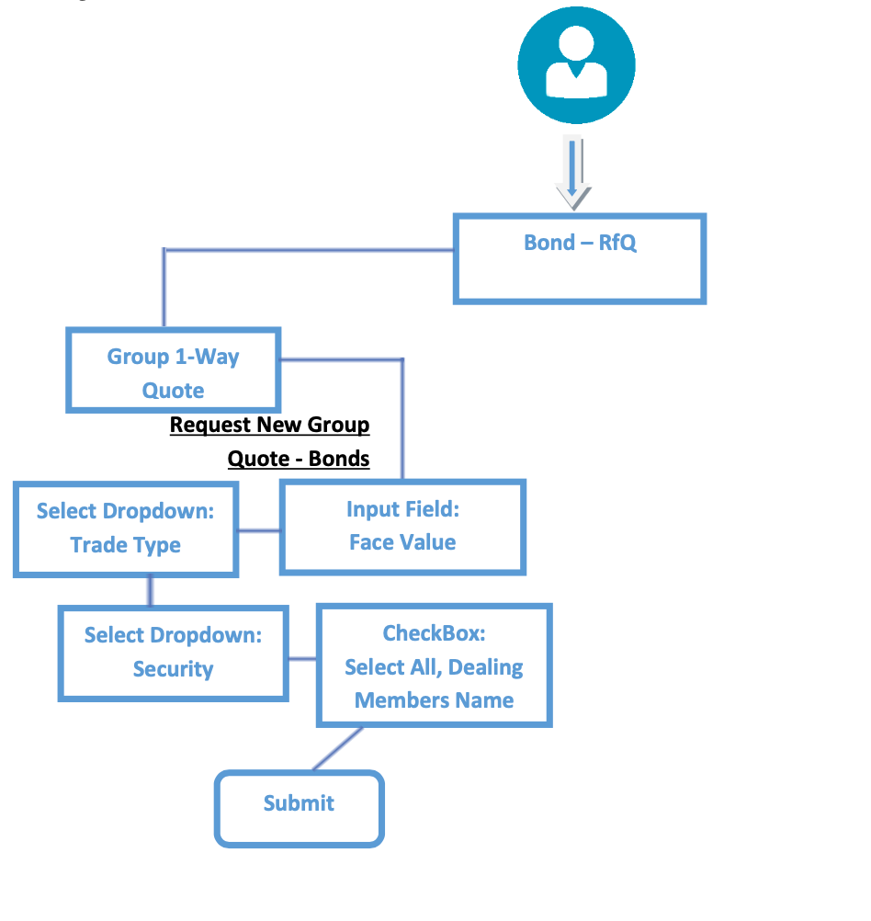
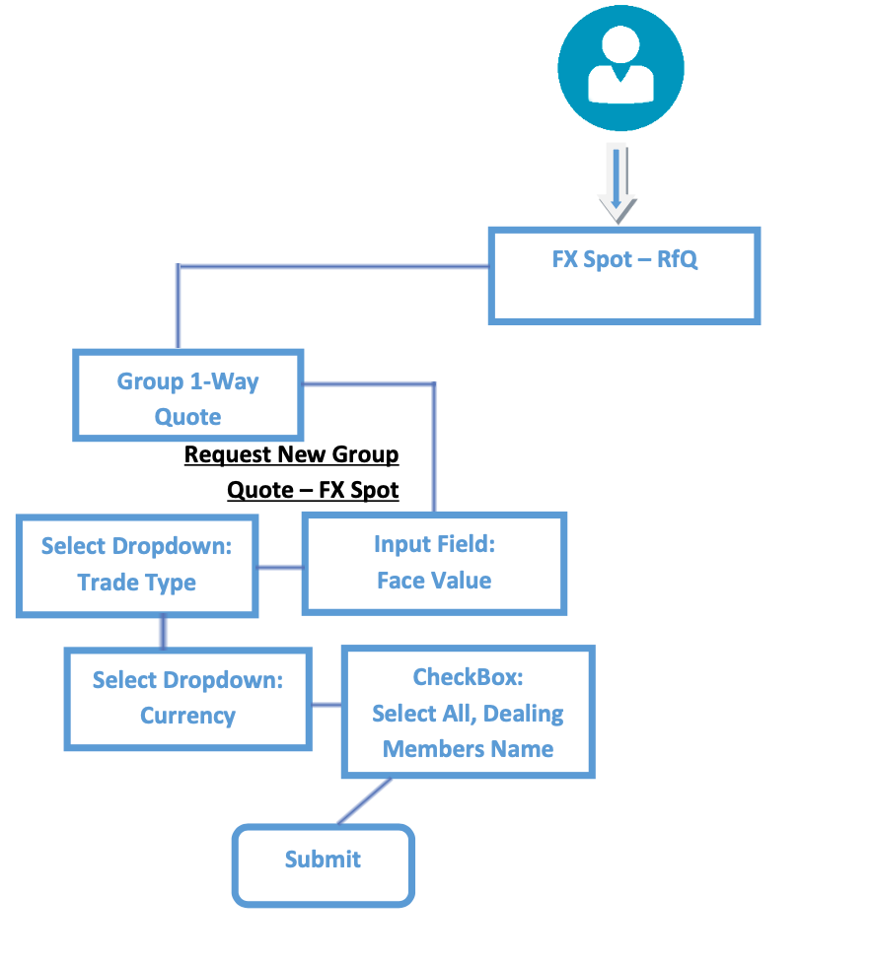
Same architecture, two applications?
7

Slide 88
Multiple Systems Operating in Silos
8
Higher Costs – building, maintaining, upgrading
Operational inefficiencies – duplication of efforts
Complexity – no overarching structure
Increased resourcing needs – time allocation

Slide 89
Evolution as opposed to Revolution
Integration Solution
Intermediate Solution
Tie together the layers and present functionality in a unified interface.
Timeframe: 3-6 months
Activities: data restructure, harmonization of application layer, unification of data protocols
Target Apps: FFTRS, FXMatch, PenDealer, Q- Deal
Final Solution
A robust scalable architecture. Services delivered on-demand.
Connect data and application layers. To deliver a more holistic operational framework.
Timeframe: 2-3 months
Activities: API creation, database organization, UI enhancement
Target Apps: e-Markets, Daily Quotation/Closing Prices
Timeframe: 12 -18 months
Activities: Operational analysis, Enterprise level re-design, Dev, Testing, Beta and Launch
Target Apps: All

Slide 90
Phase one
New Databases
10
User Interface
Existing Databases
Existing Applications
APIs
Initially select applications will be delivered through a new user interface whilst existing applications will continue to run as before

Slide 91
Phase two
RT Trading
User Interface
New Databases
Existing Applications
APIs
Existing Databases
At this stage existing applications will run in conjunction between a user interface and RT Trading
©

Slide 92
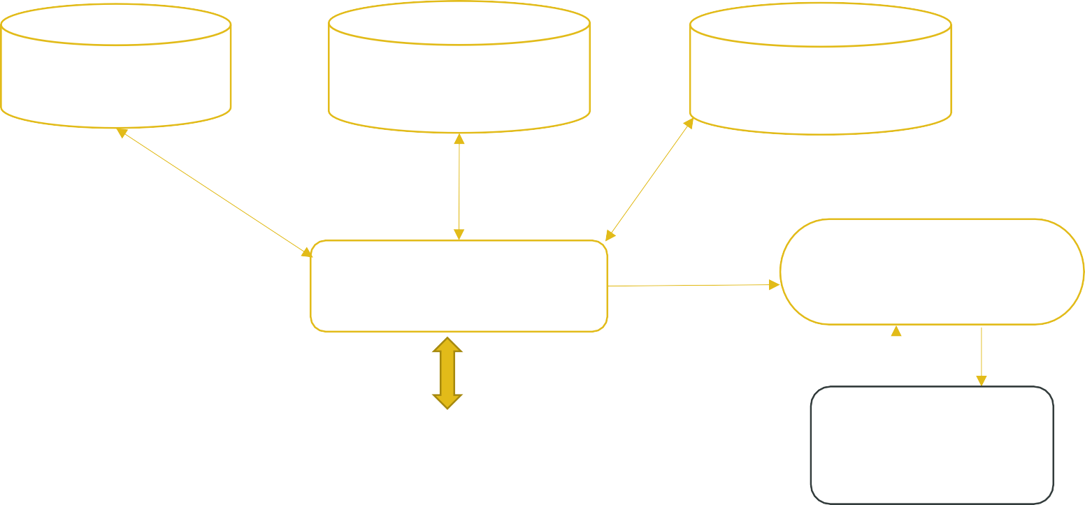
Phase three
12
Security Master Futures/Bills/Bonds
Trade data, quotes, pricing
Document Repository
Application Layer Trading, Monitoring, Reporting
Settlement & Clearing Engine
Unified User Interface – Dealers, Admins, Regulators etc
Clearing House/Trade Repository/CSD
This shows a simplified view of the main system architecture
©

Slide 93
Conclusion
To conclude, we propose is a phased implementation with clear milestones to move from the current situation to a target operating model. The benefits of this approach are:
We can maintain current systems and phase them out gradually with limited business interruption It enables us to test and enhance modules without affecting critical processes
As we progress it will be easier to adapt for further functionality or new products

Slide 94
Proposed approach
We will use an AGILE approach with 2 week sprints.
We will assess all parts of the business , providing a Gap analysis.
We will delopy a business analyst, systems Architect and relationship manager. We will provide supporting wireframes to help with the Kick-off.
Consultative approach reviewing all aspects of FMDQ with 15 years + Fintech & financial Markets experience.

Slide 95
Gartner CIO IT Score

Slide 96
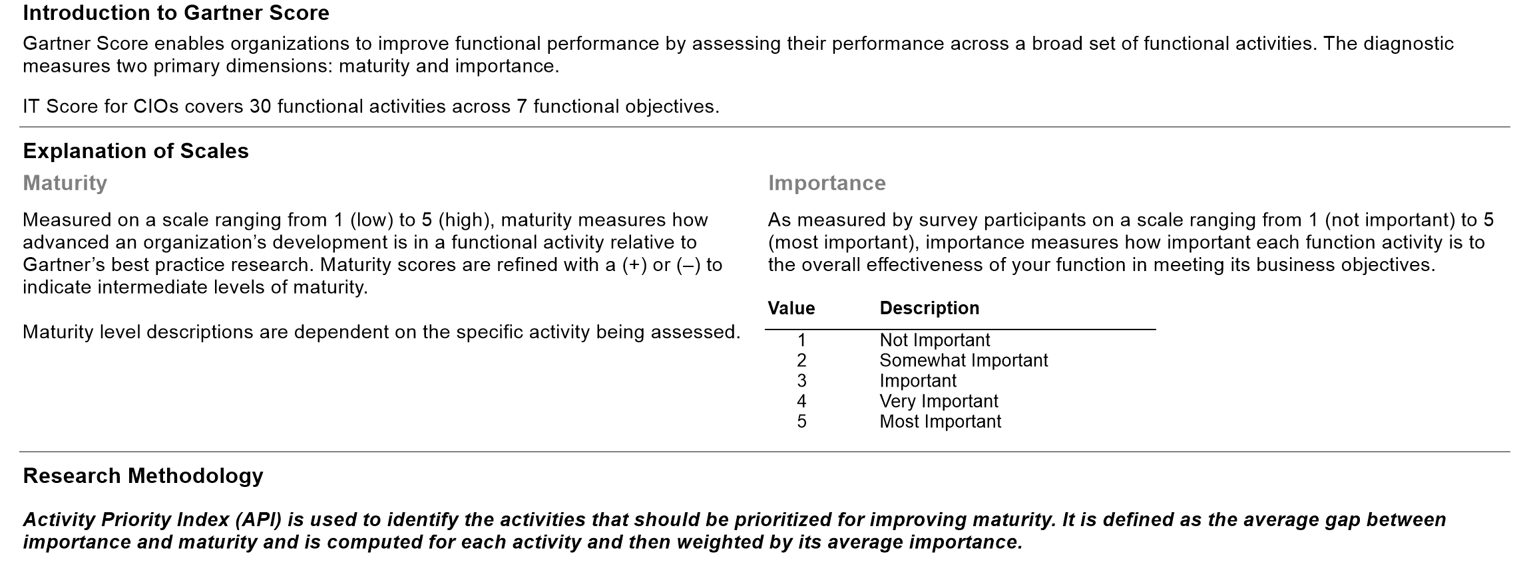
Appendix: Gartner Score Overview

Slide 97
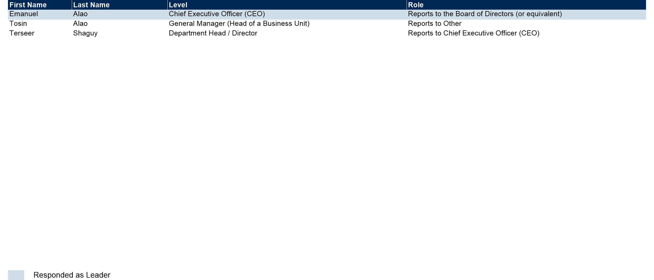
Appendix: Business Participants

Slide 98
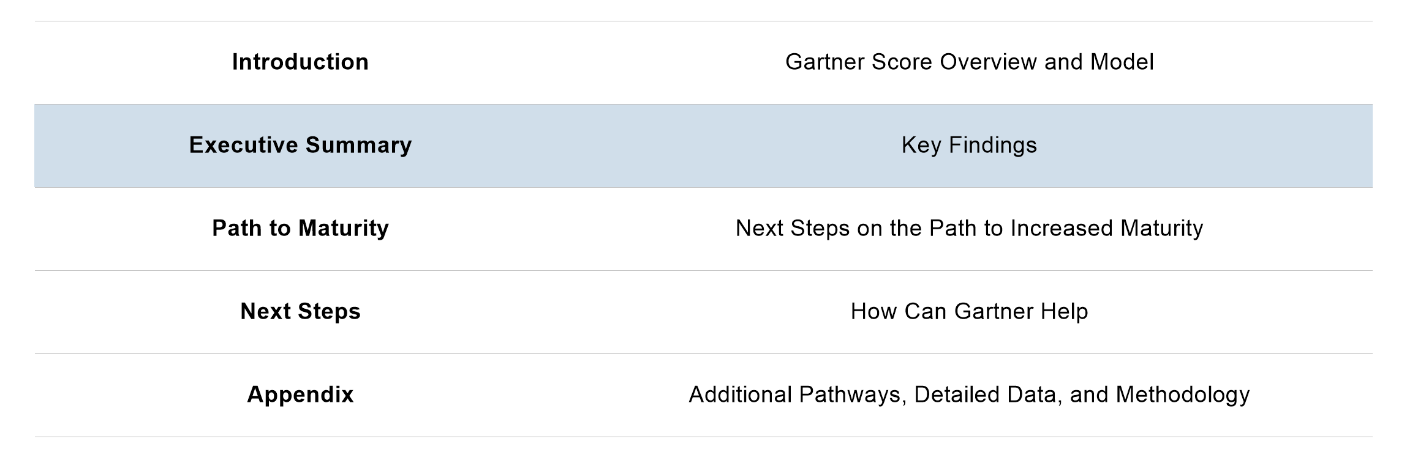
Report Roadmap

Slide 99
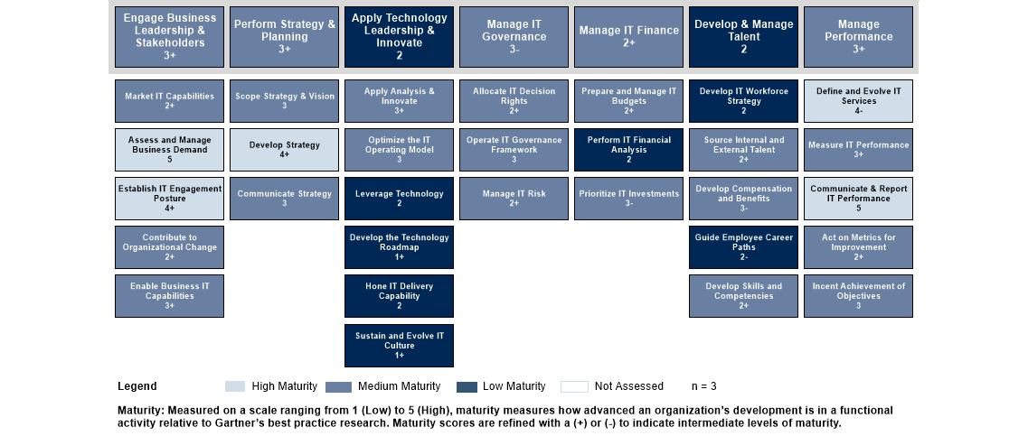
How Mature Are Our Functional Activities?

Slide 100
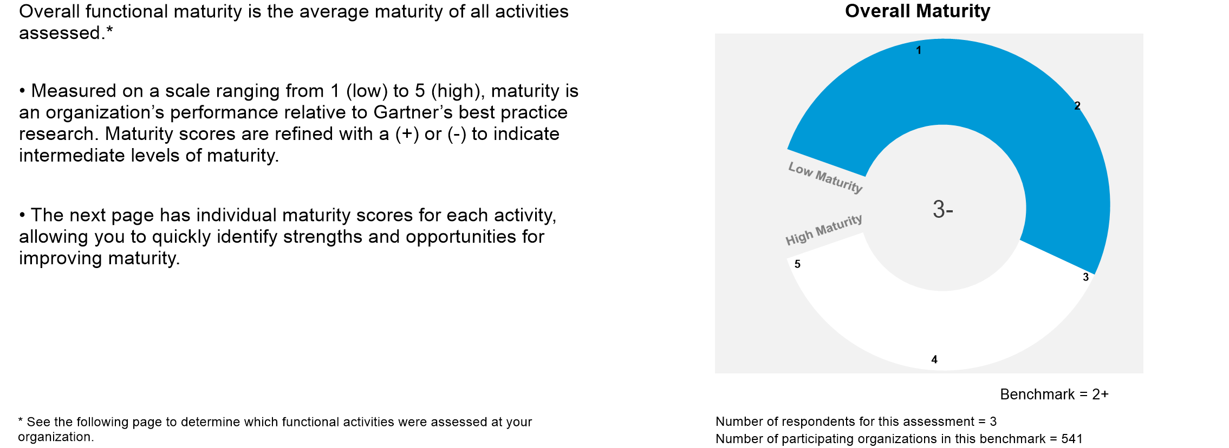
Appendix: What is Our Overall Maturity?

Slide 101
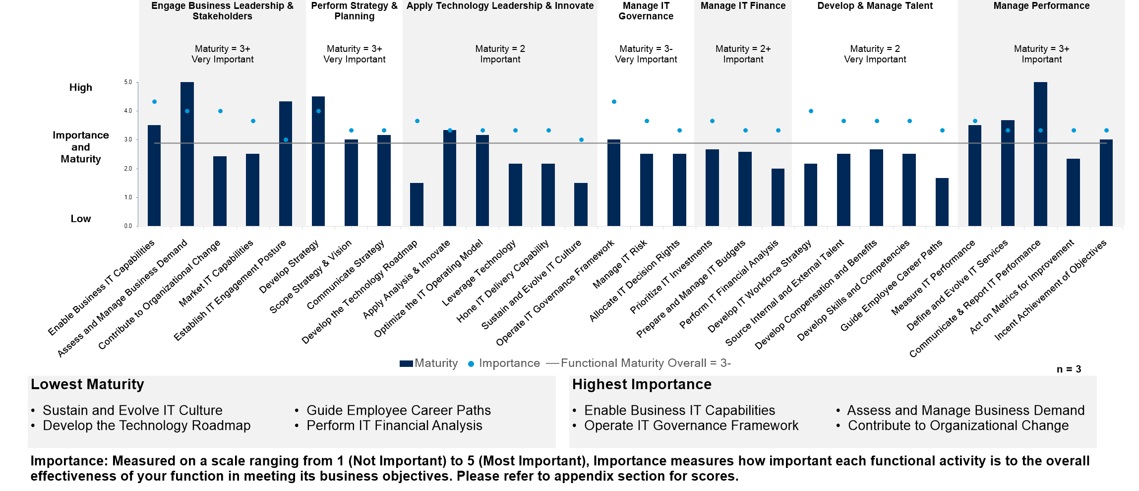
Appendix: How Do Maturity and Importance Compare?

Slide 102
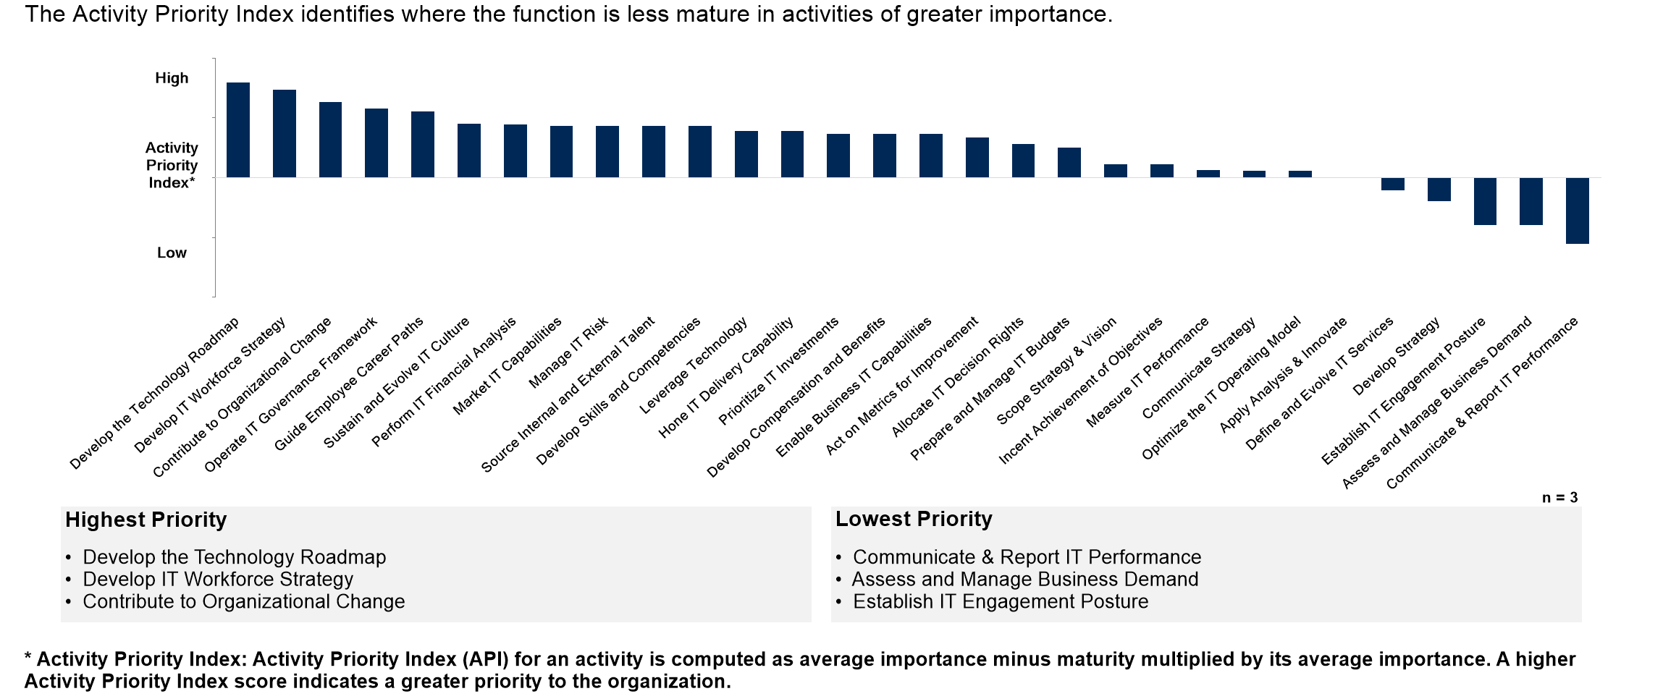
Appendix: What are the High Priority Areas for Our Function?

Slide 103
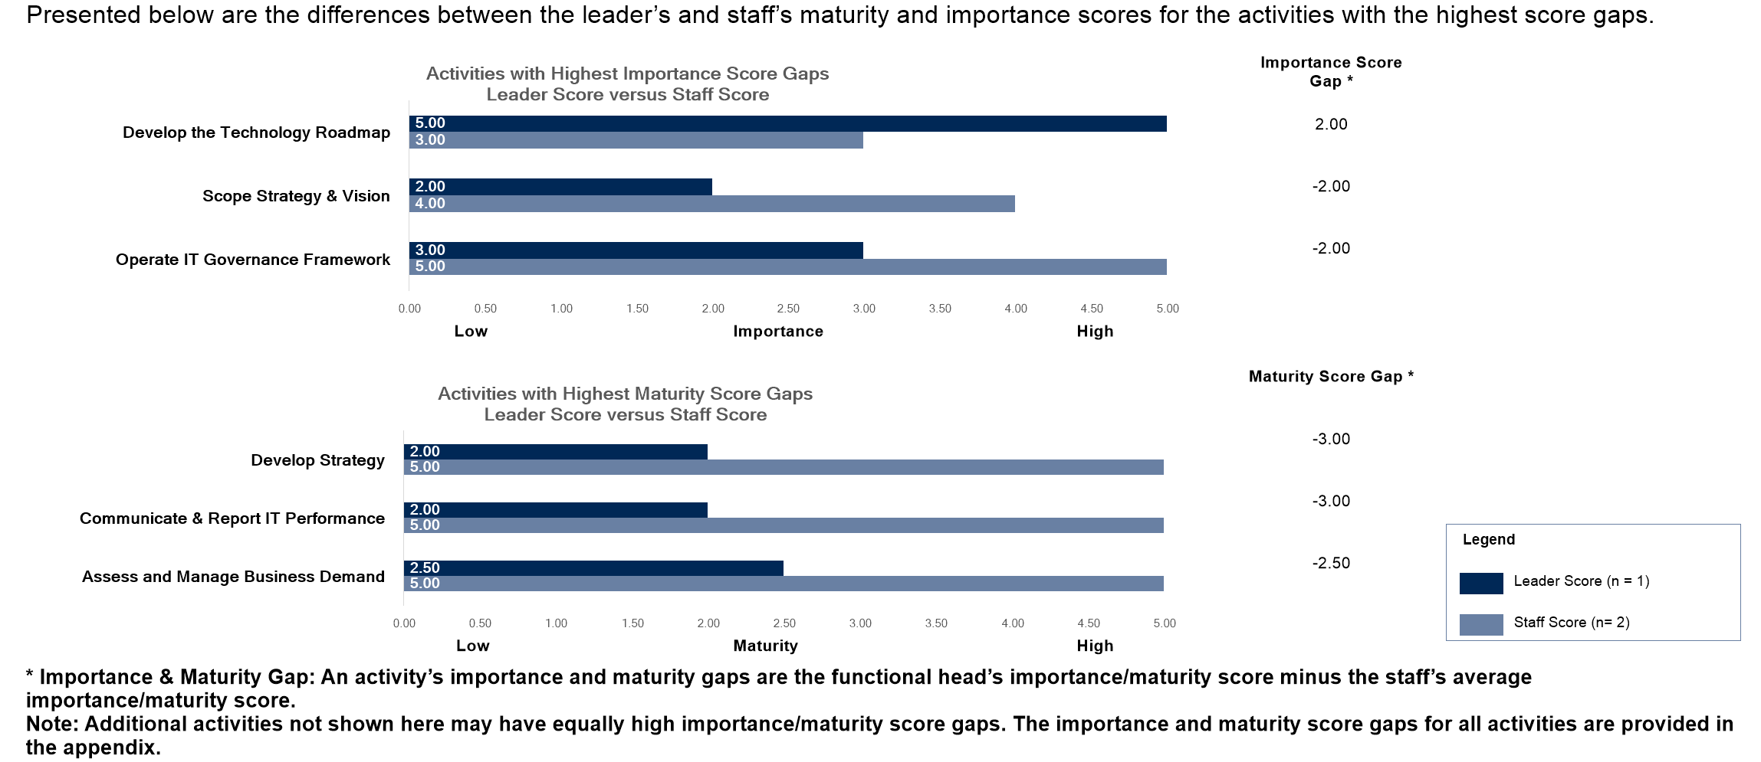
Appendix: Do We Have Team Consensus on Maturity and Importance?

Slide 104
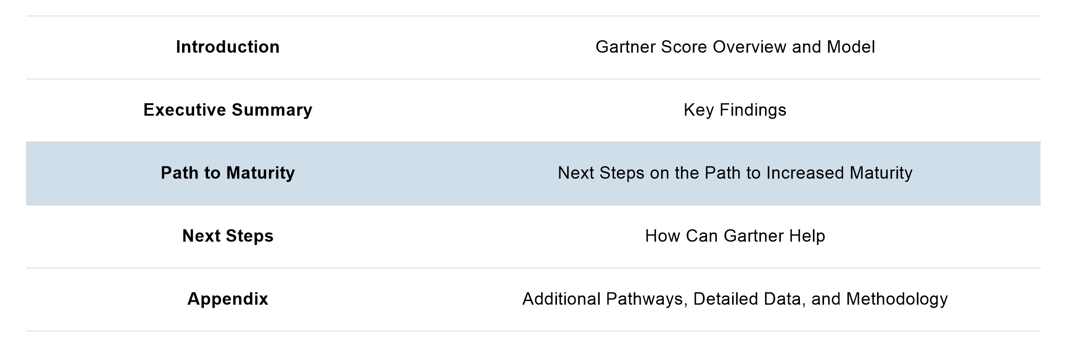
Report to Roadmap

Slide 105
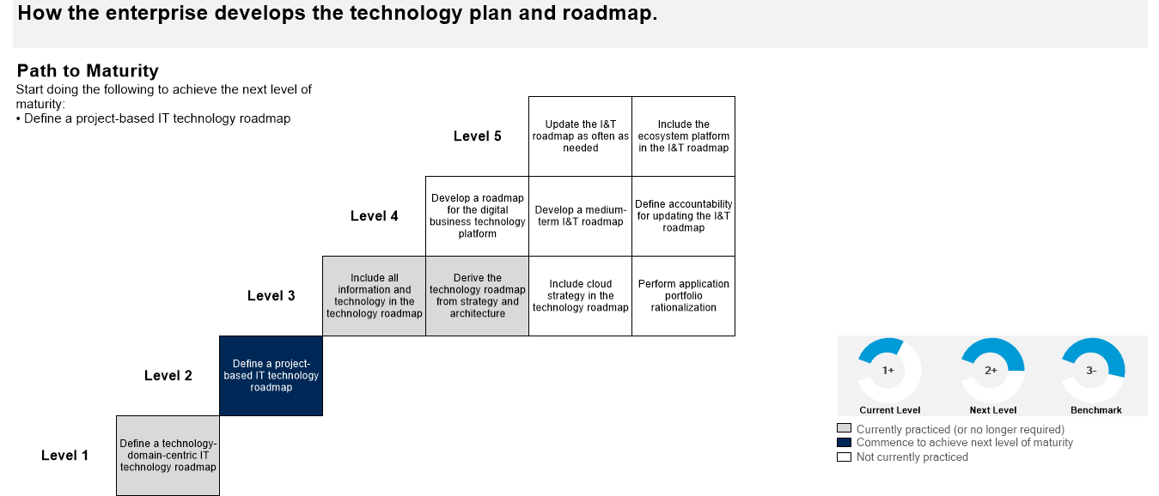
Develop the Technology Roadmap
How the business develops the technology plan and roadmap.

Slide 106
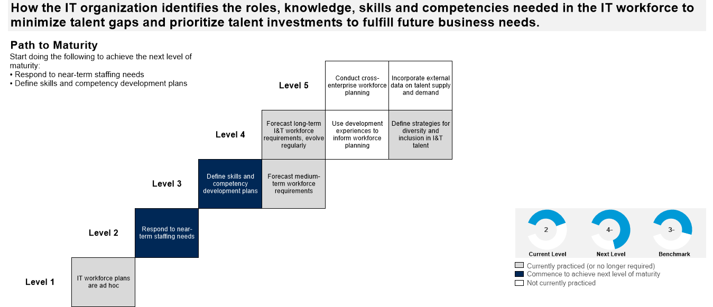
Develop IT Workforce Strategy
How the business identifies the roles, knowledge, skills and competencies needed in the IT workforce to minimise talent gaps and prioritises talent investments to fulfil future business needs.

Slide 107
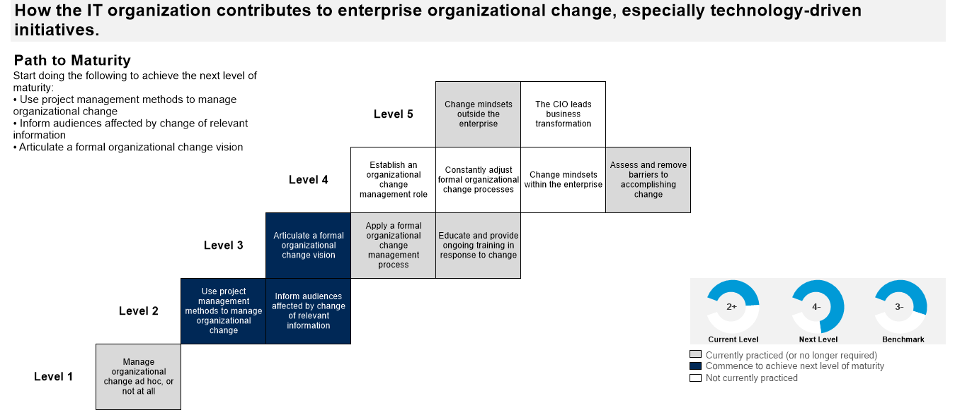
Contribute to Organisational Change
How the business contributes to enterprise organisational change, especially technology-driven initiatives

Slide 108
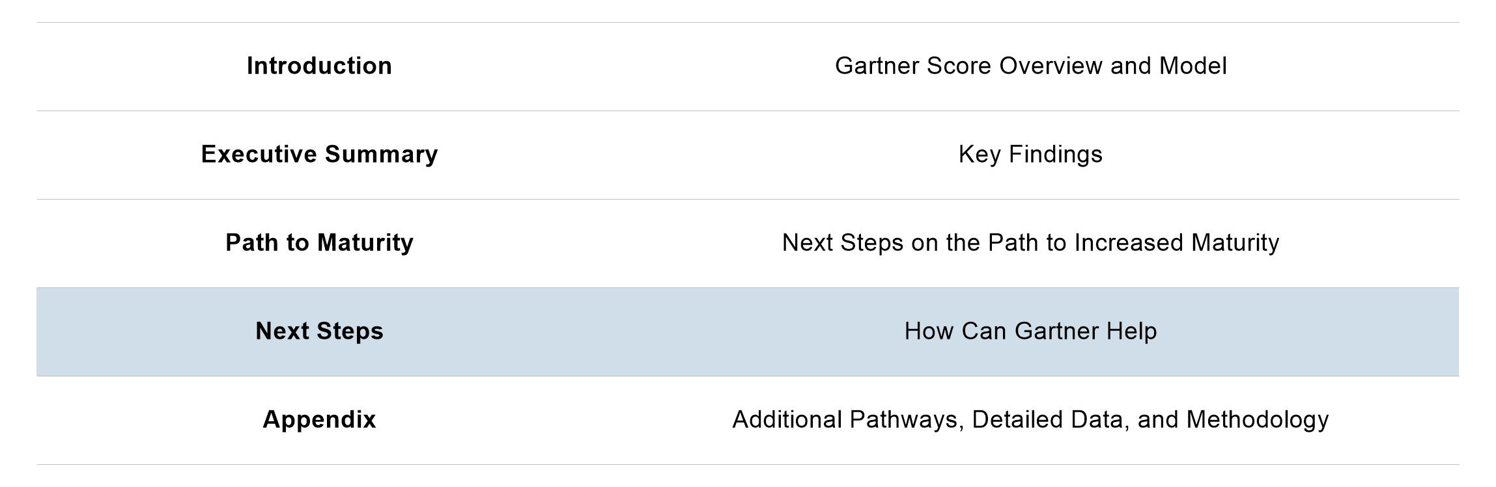
Report Roadmap

Slide 109
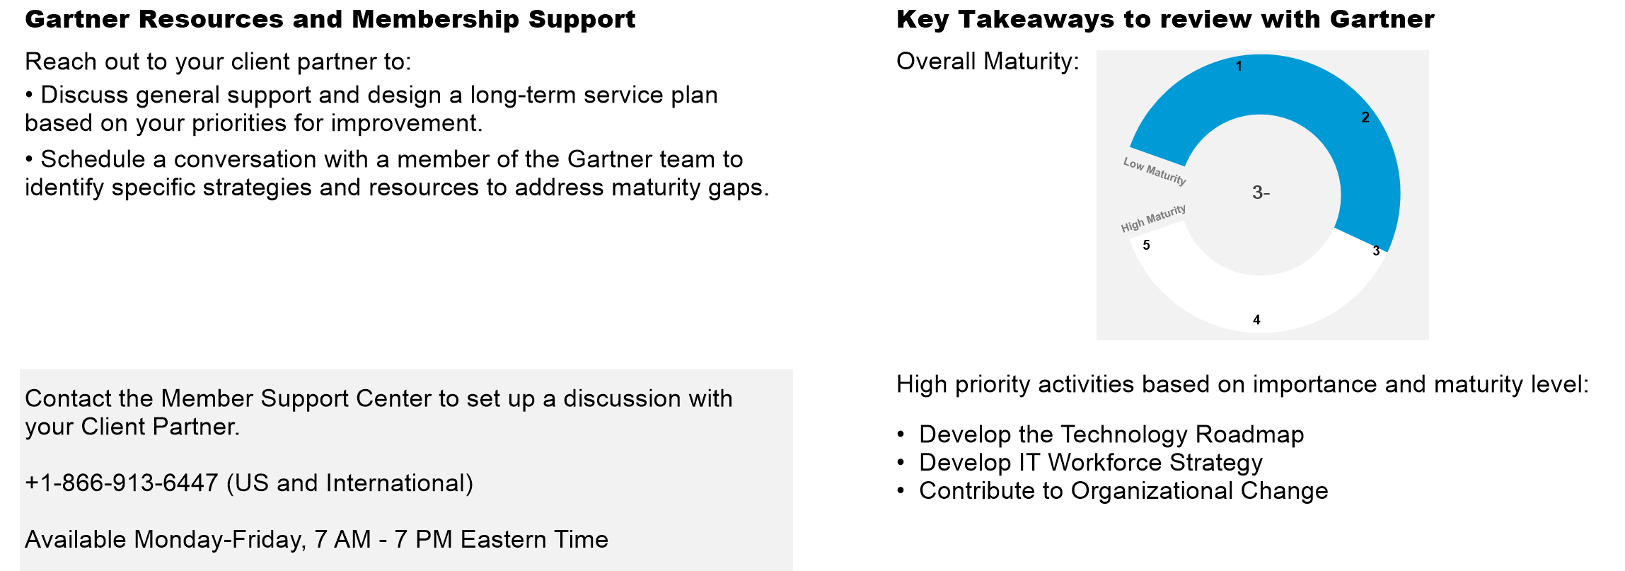
How can Gartner help us?

Slide 110
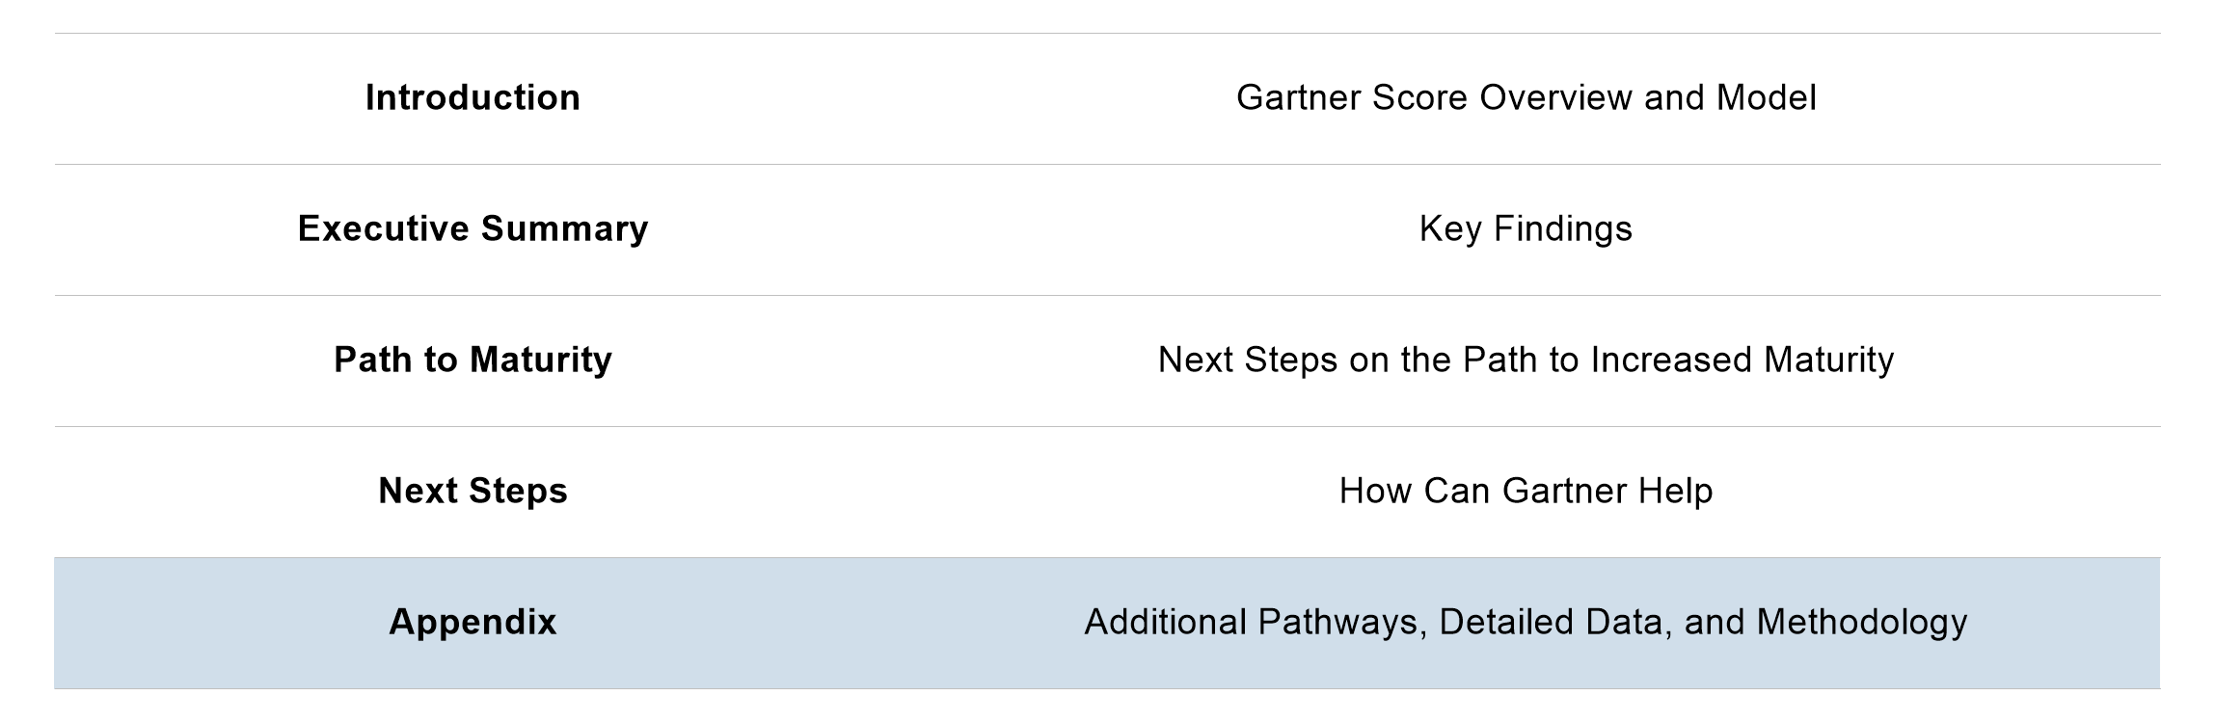
Report Roadmap

Slide 111
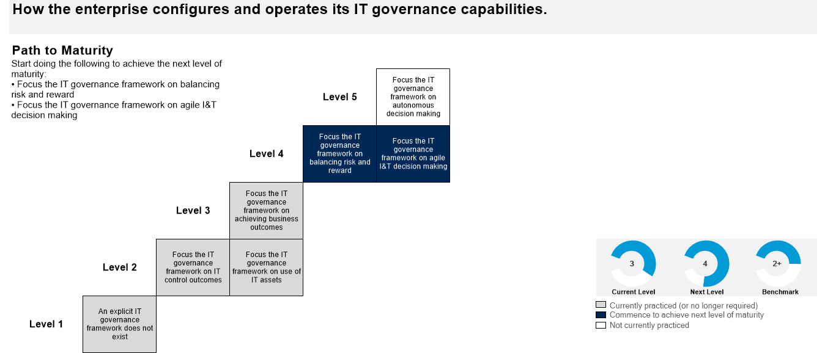
Operate IT Governance Framework
How the business configures and operates its IT governance capabilities

Slide 112
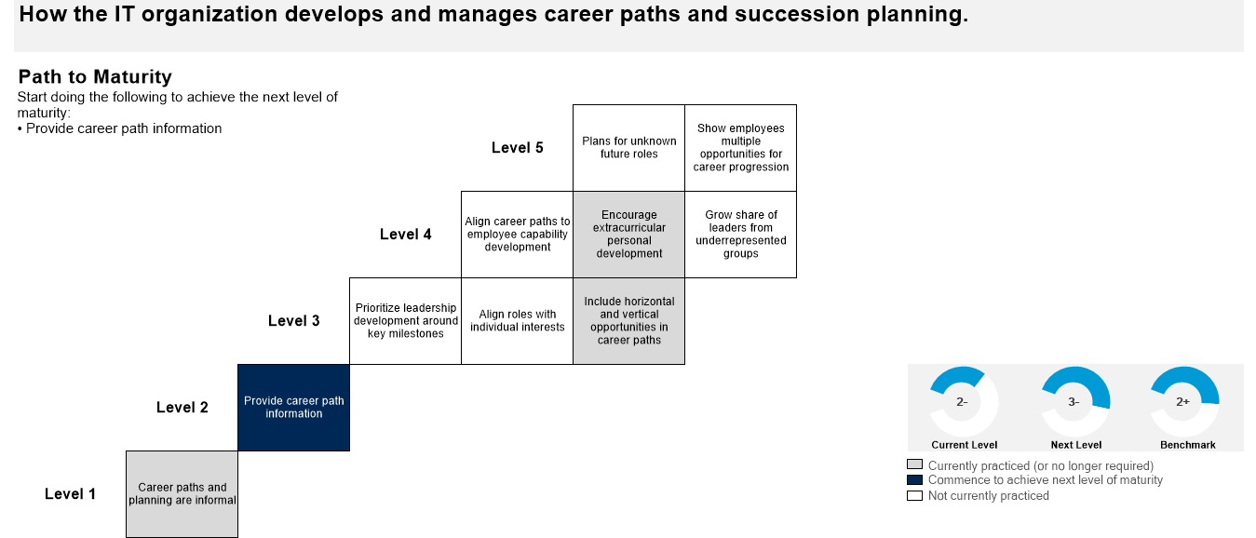
Guide Employee Career Paths
How the business develops and manages career paths and succession planning.

Slide 113
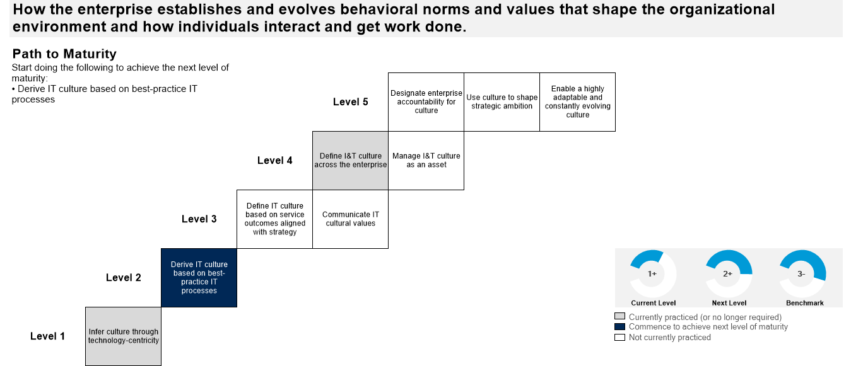
Sustain and Evolve IT Culture
How the business establishes and evolves behavioural norms and values that shape the organisational environment and how individuals interact and get work done.

Slide 114
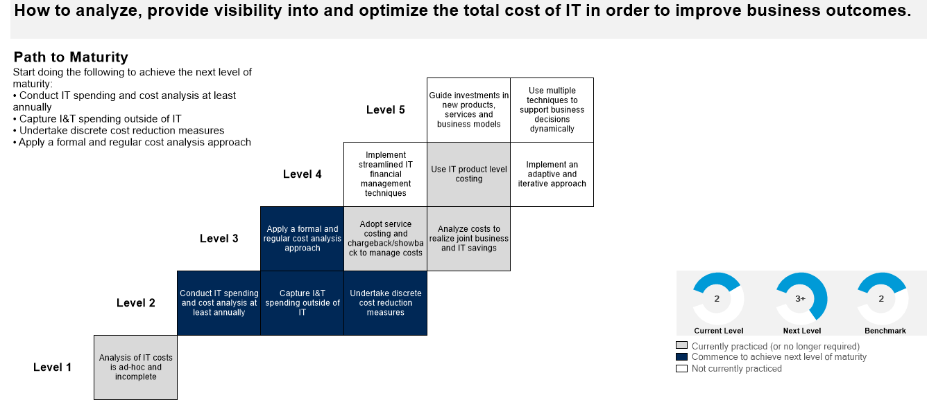
Perform IT Financial Analysis
How to analyse, provide visibility into and optimise the total cost of IT in order to improve business outcomes.

Slide 115
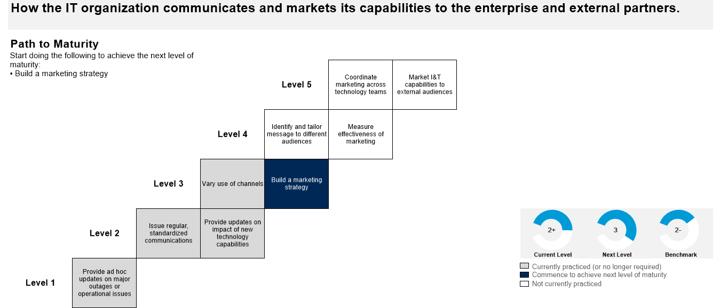
Market IT Capabilities
How the business communicates and markets its capabilities to the group and external partners.

Slide 116
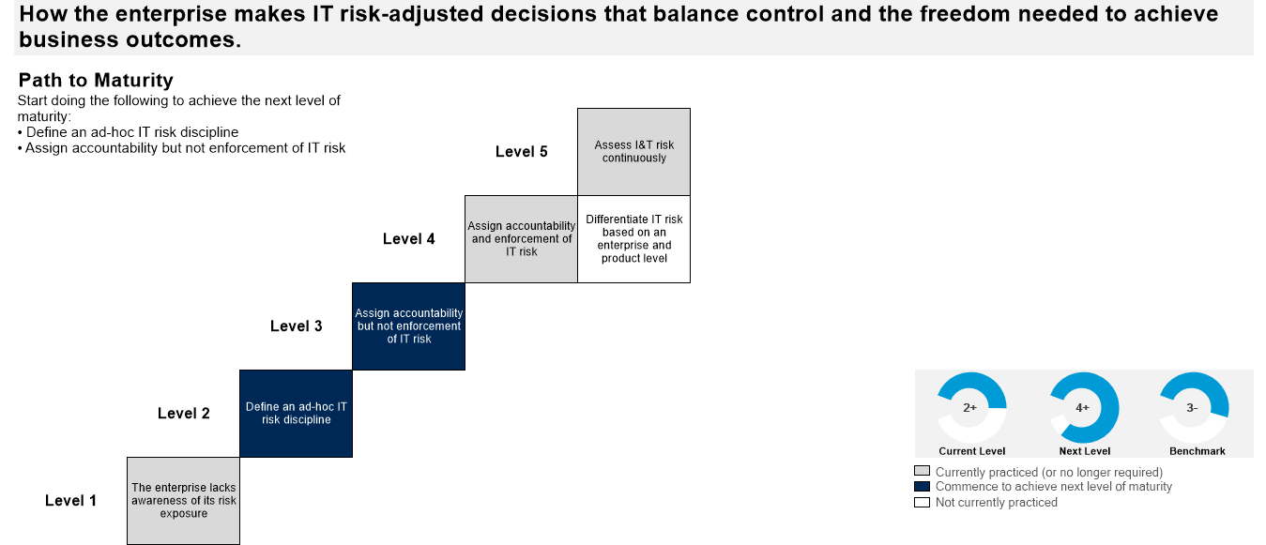
Manage IT Risk
How the business makes IT risk-adjusted decisions that balance control and the freedom needed to achieve business outcomes.

Slide 117
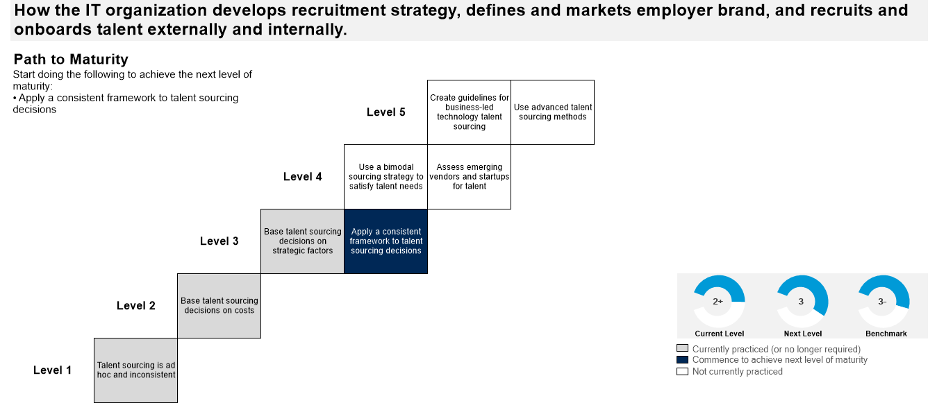
Source Internal and External Talent
MANAGED
How the business develops recruitment strategy, defines and markets employer brand, and recruits and onboards talent externally and internally

Slide 118
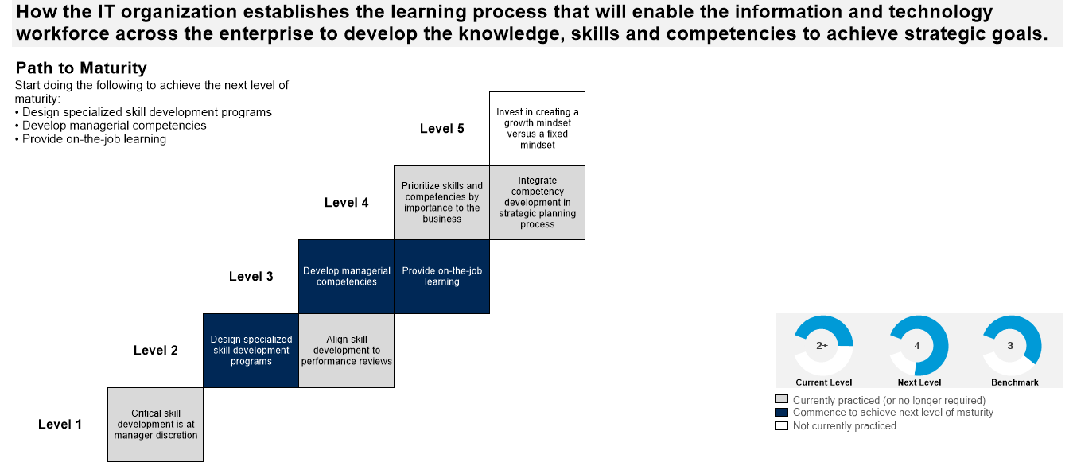
Develop Skills and Competencies
MANAGED
How the business establishes the learning process that will enable the information and technology workforce across the enterprise to develop the knowledge, skills and competencies to achieve strategic goals

Slide 119
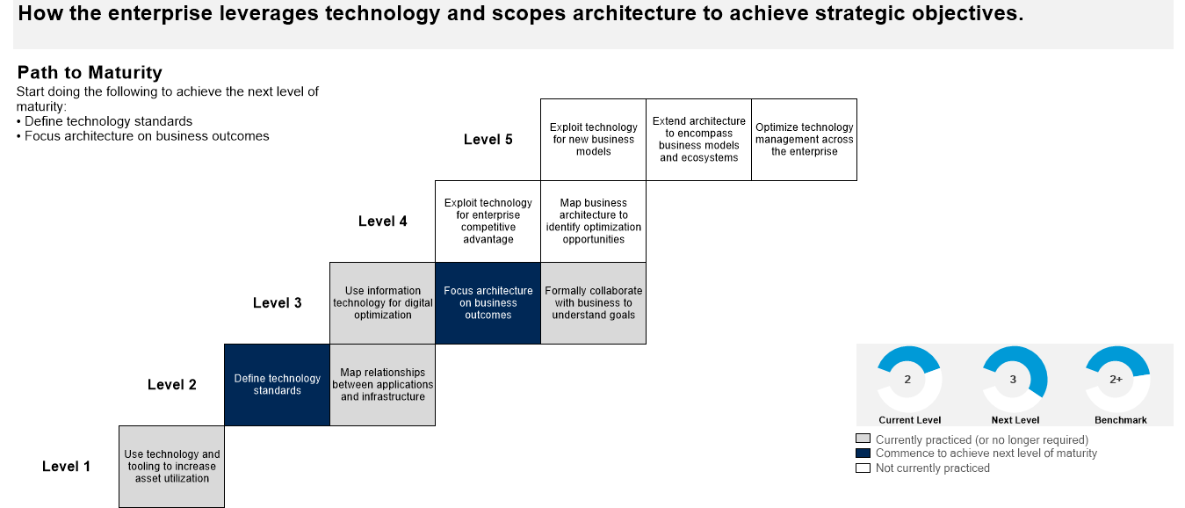
Leverage Technology
How the business leverages technology and scopes architecture to achieve strategic objectives.

Slide 120
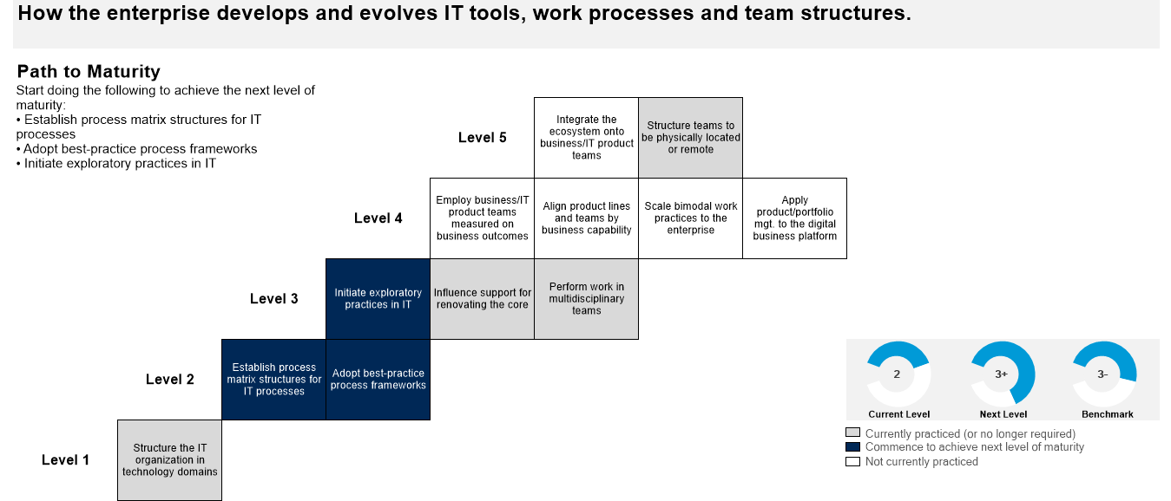
Hone IT Delivery Capability
How the business develops and evolves IT tools, work processes and team structures.

Slide 121
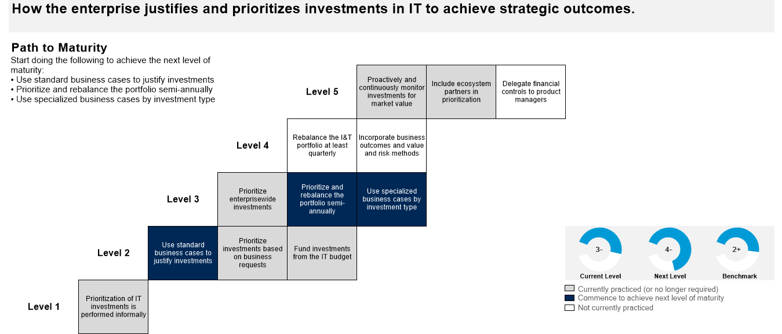
Prioritise IT Investments
How the business justifies and prioritises investments in IT to achieve strategic outcomes.

Slide 122
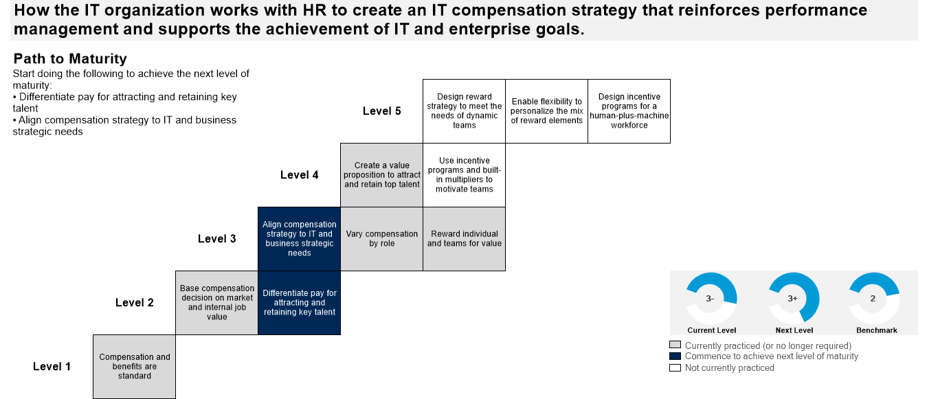
Develop Compensation and Benefits
How the business works with HR to create and IT compensation strategy that reinforces performance management and supports the achievement of IT enterprise goals.

Slide 123
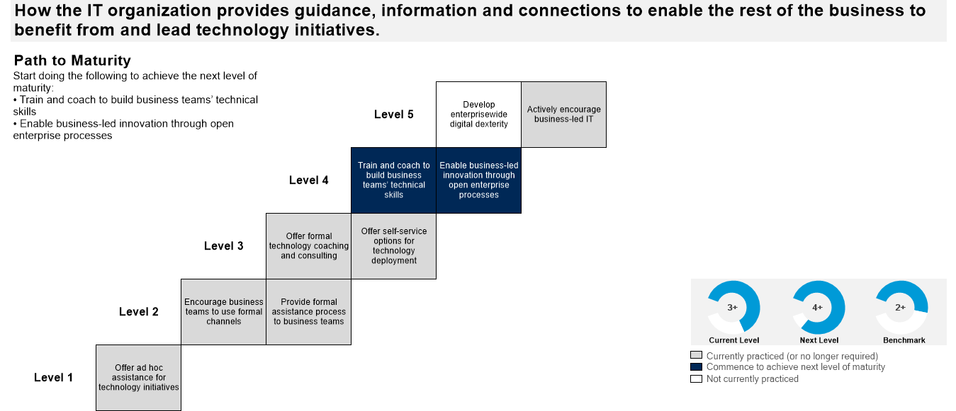
Enable Business IT Capabilities
How the business provides guidance, information and connections to enable the rest of the business to benefit from and lead technology initiatives

Slide 124
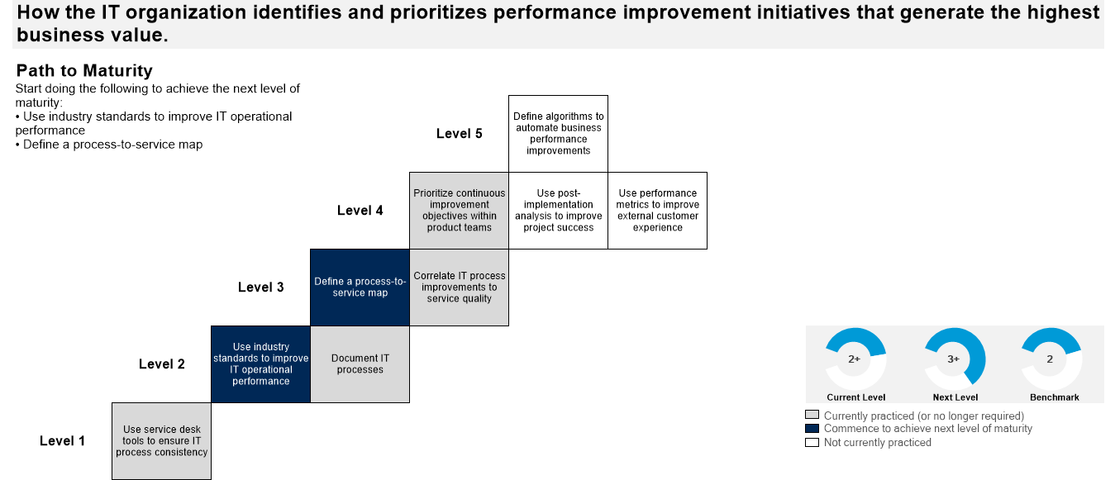
Act on Metrics for Improvement
How the business identifies and prioritises performance improvement initiatives that generate the highest business value.

Slide 125
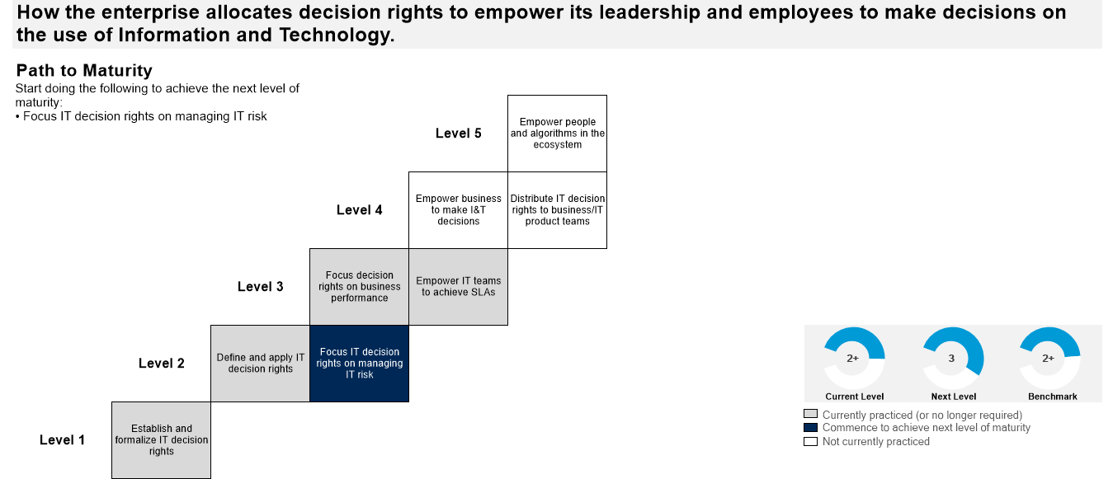
Allocate IT Decision Rights
How the business allocates decision rights to empower its leadership and employees to make decisions on the use of Information and Technology

Slide 126
Prepare and Manage IT Budgets
How the business identifies and prioritises performance improvement initiatives that generate the highest business value.

Slide 127
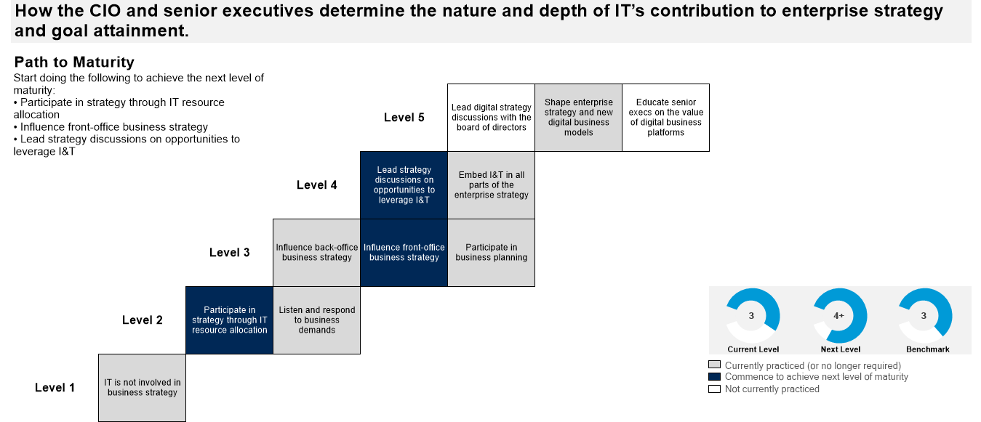
Scope, Strategy and Vision
How the MD and senior executives determine the nature and depth of IT’s contribution to enterprise strategy and goal attainment

Slide 128
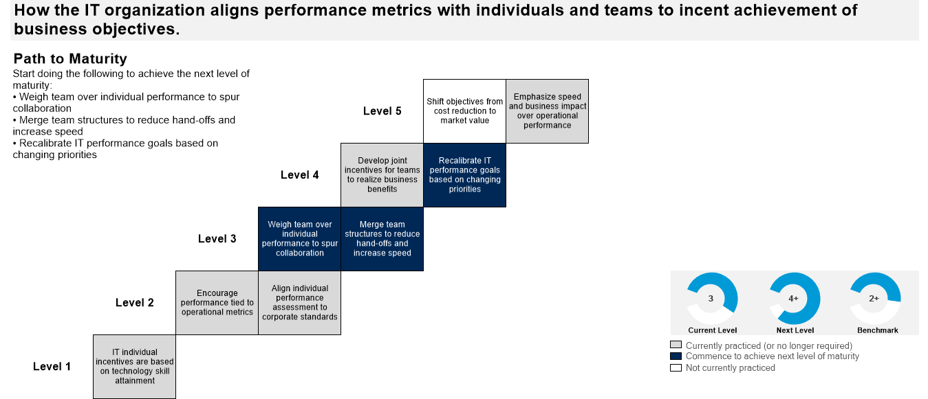
Incent Achievement of Objectives
How the business aligns performance metrics with individuals and teams to incent achievement of business objectives.

Slide 129
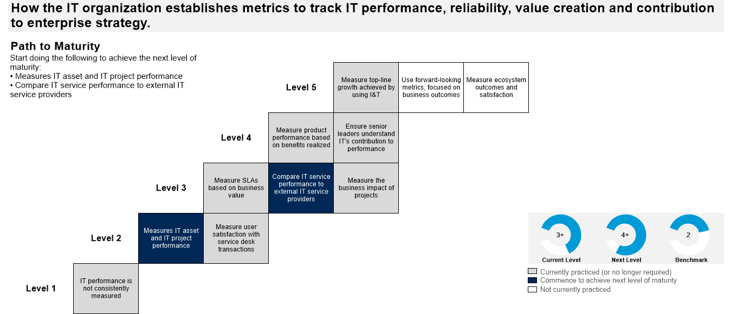
Measure IT Performance
How the business establishes metrics to track performance, reliability, value creation and contribution to business strategy.

Slide 130
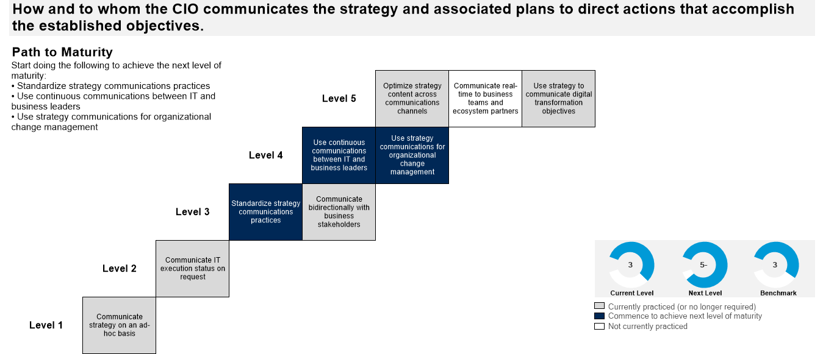
Communicate Strategy
How and to whom the MD communicates the strategy and associated plans to direct actions that accomplish the established objectives

Slide 131
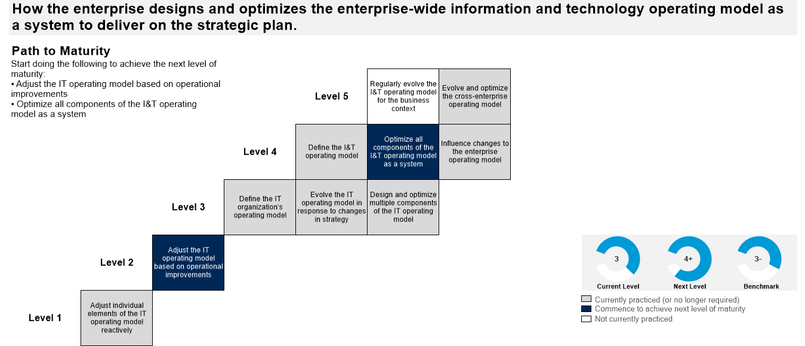
Optimise the IT Operating Model
How the business designs and optimises the enterprise-wide information and technology operating model as a system to deliver on the strategic plan.

Slide 132
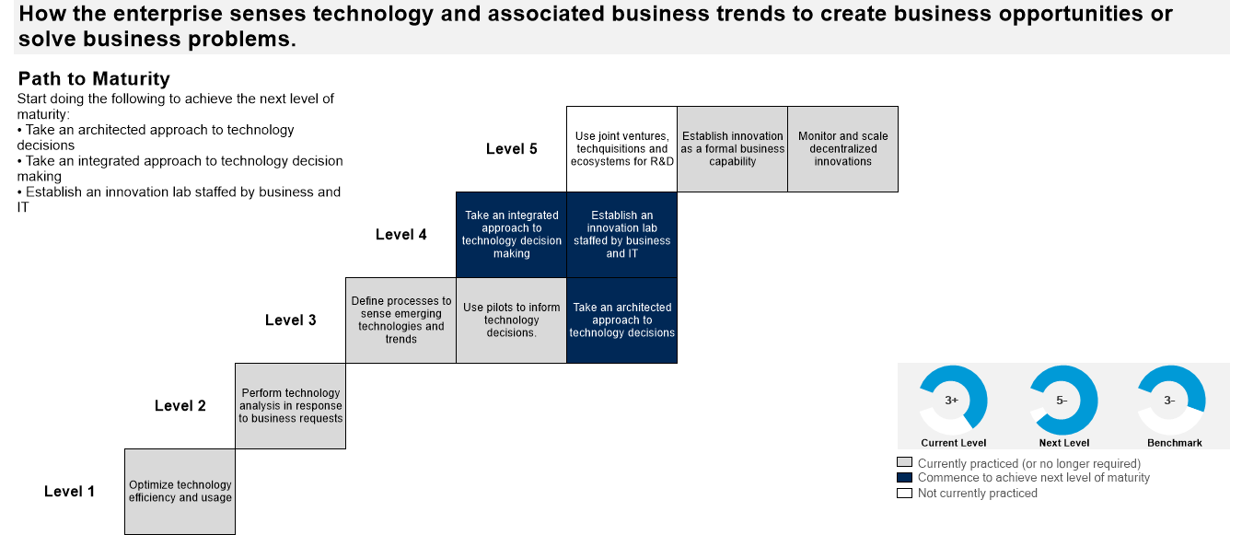
Apply Analysis & Innovate
How the business senses technology and associated business trends to create business opportunities or solve business problems

Slide 133
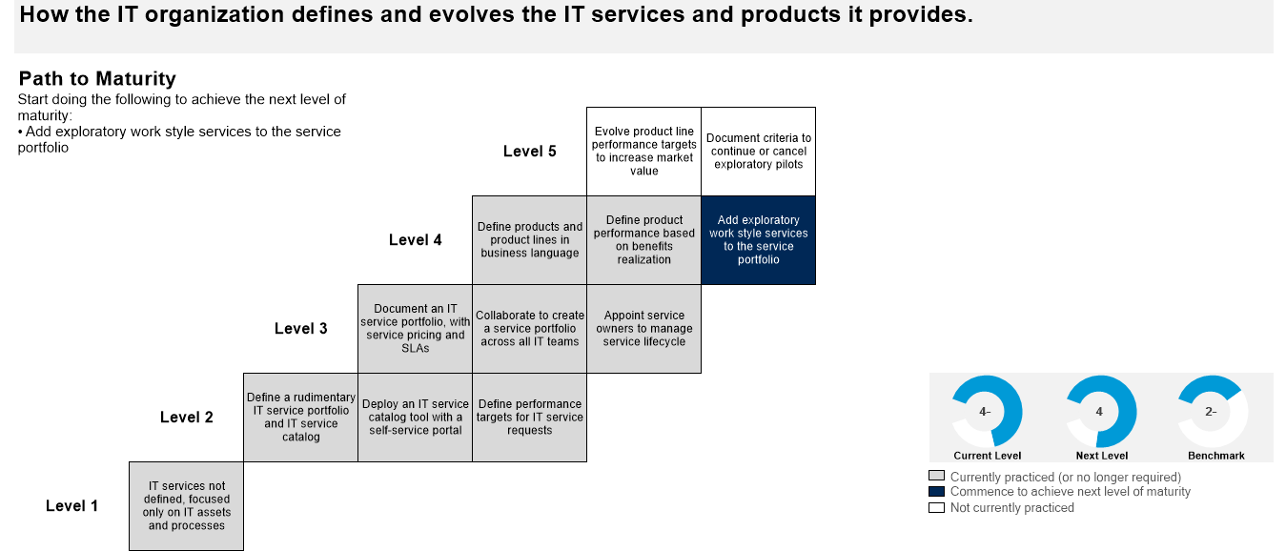
Define and Evolve IT Services
How the business defines and evolves the IT services and products it provides.

Slide 134
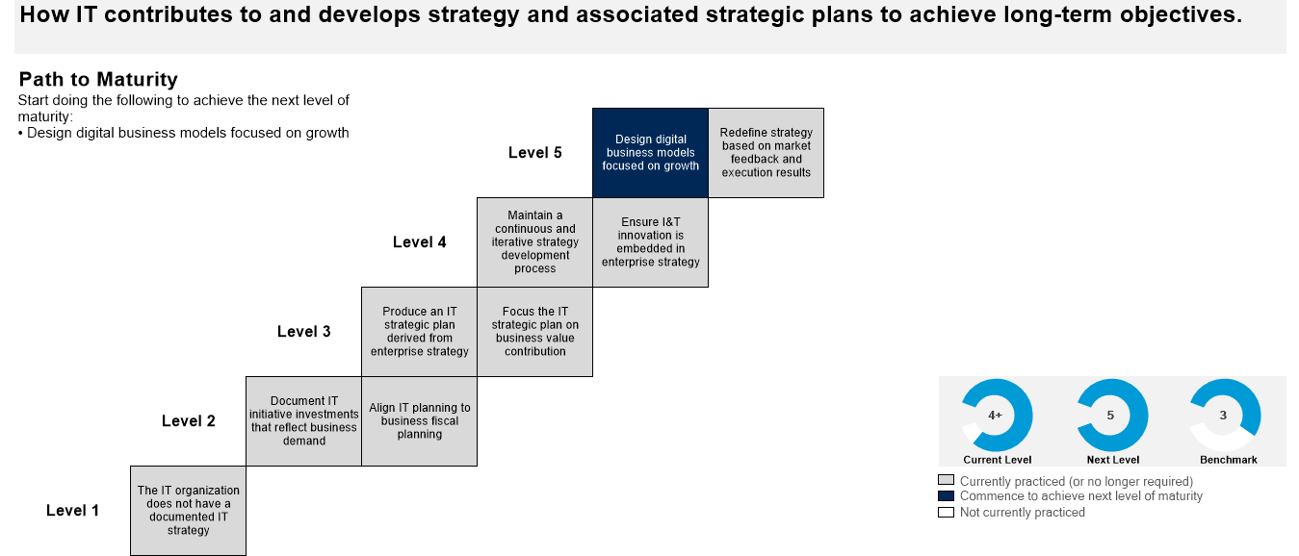
Develop Strategy
How IT contributes to and develops strategy and associated strategic plans to achieve long-term objectives

Slide 135
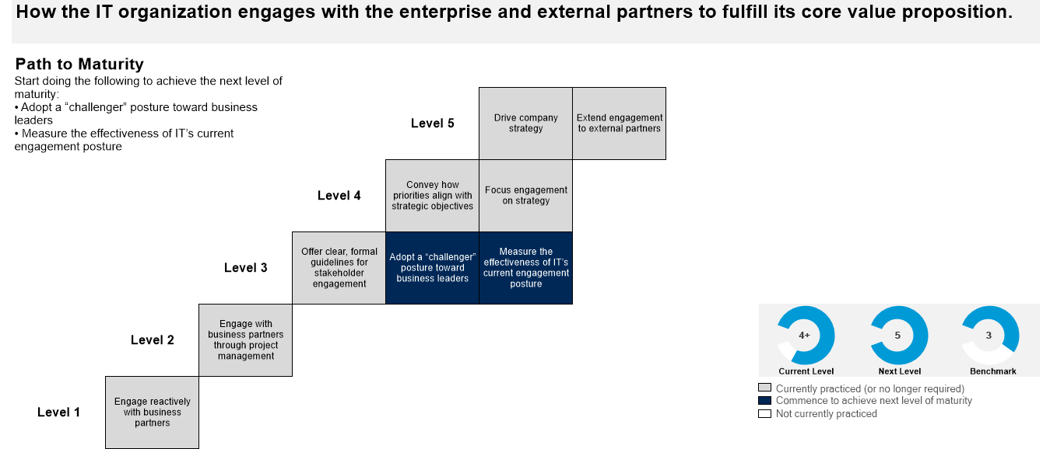
Establish IT Engagement Posture
How the business engages with the enterprise and external partners to fulfil its core value proposition

Slide 136
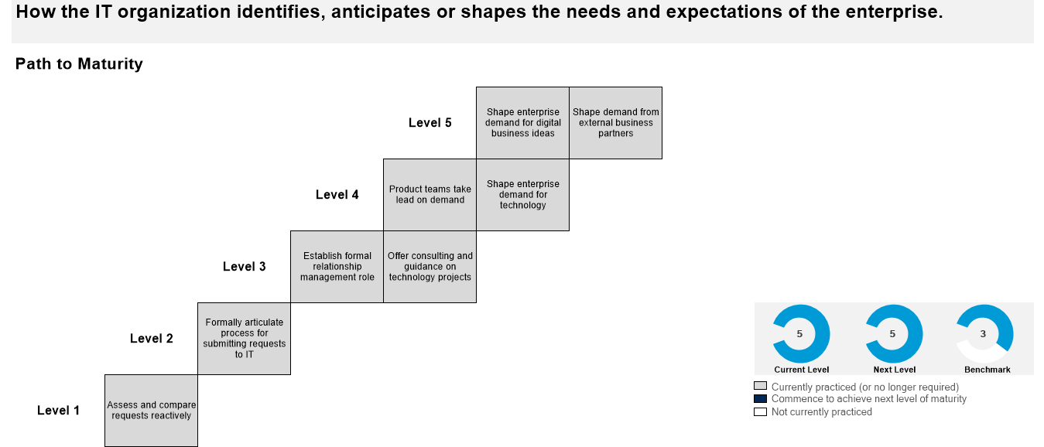
Assess and Manage Business Demand
How the business identifies, anticipates or shapes the needs and expectations of the enterprise.

Slide 137
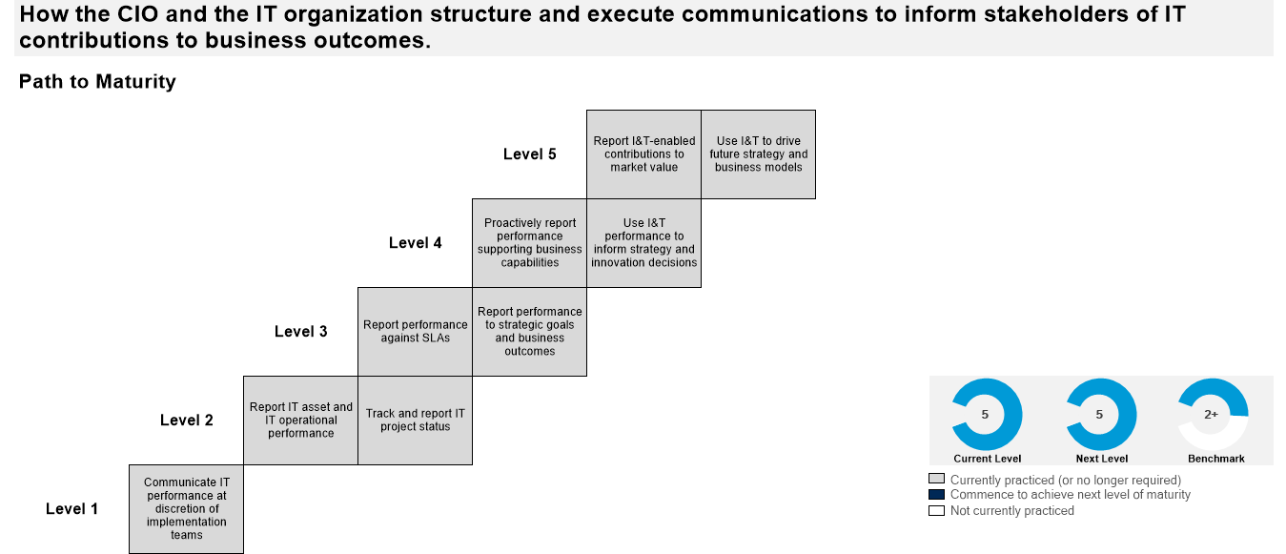
Communicate & Report IT Performance
How the MD and the business structure and execute communications to inform stakeholders of IT contributions to business outcomes.

Slide 138
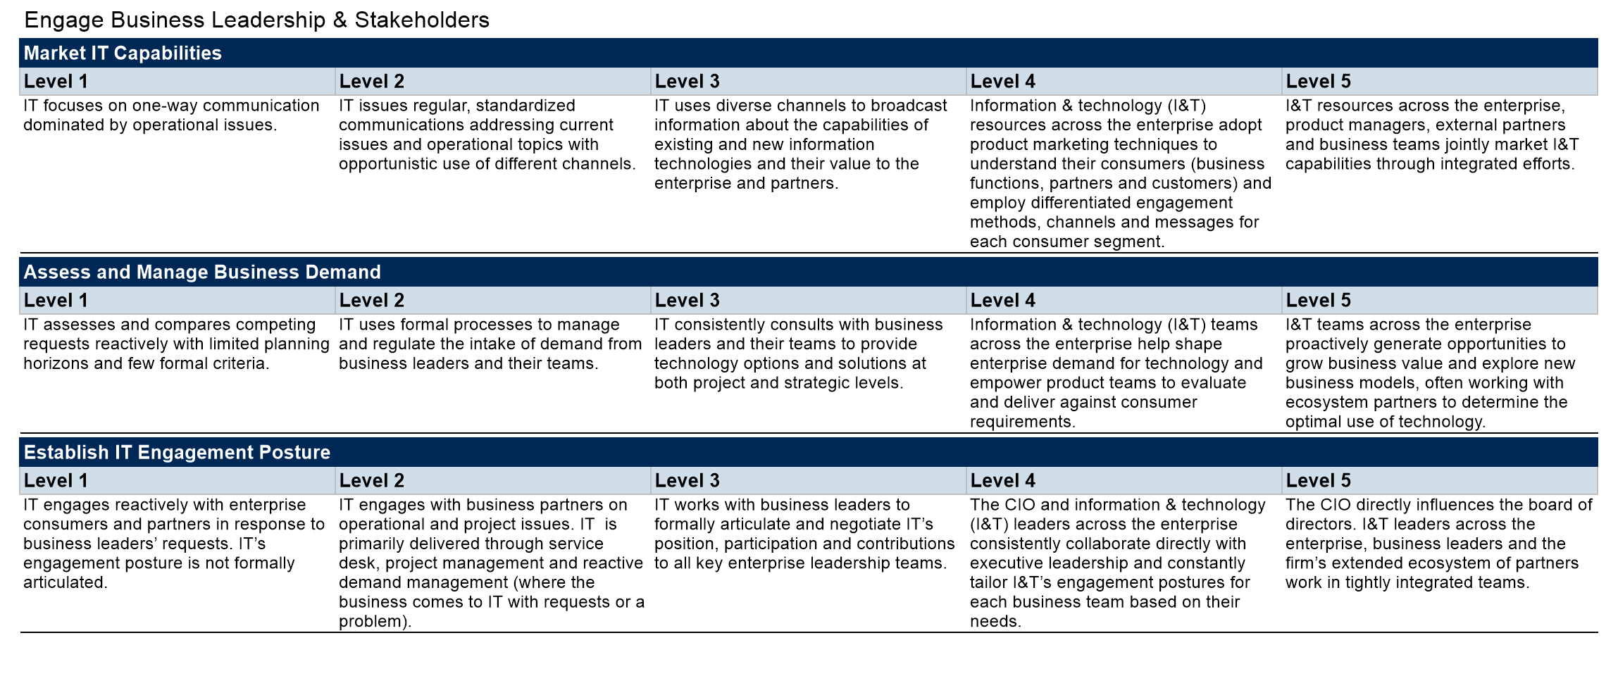
Mature Level Definitions

Slide 139
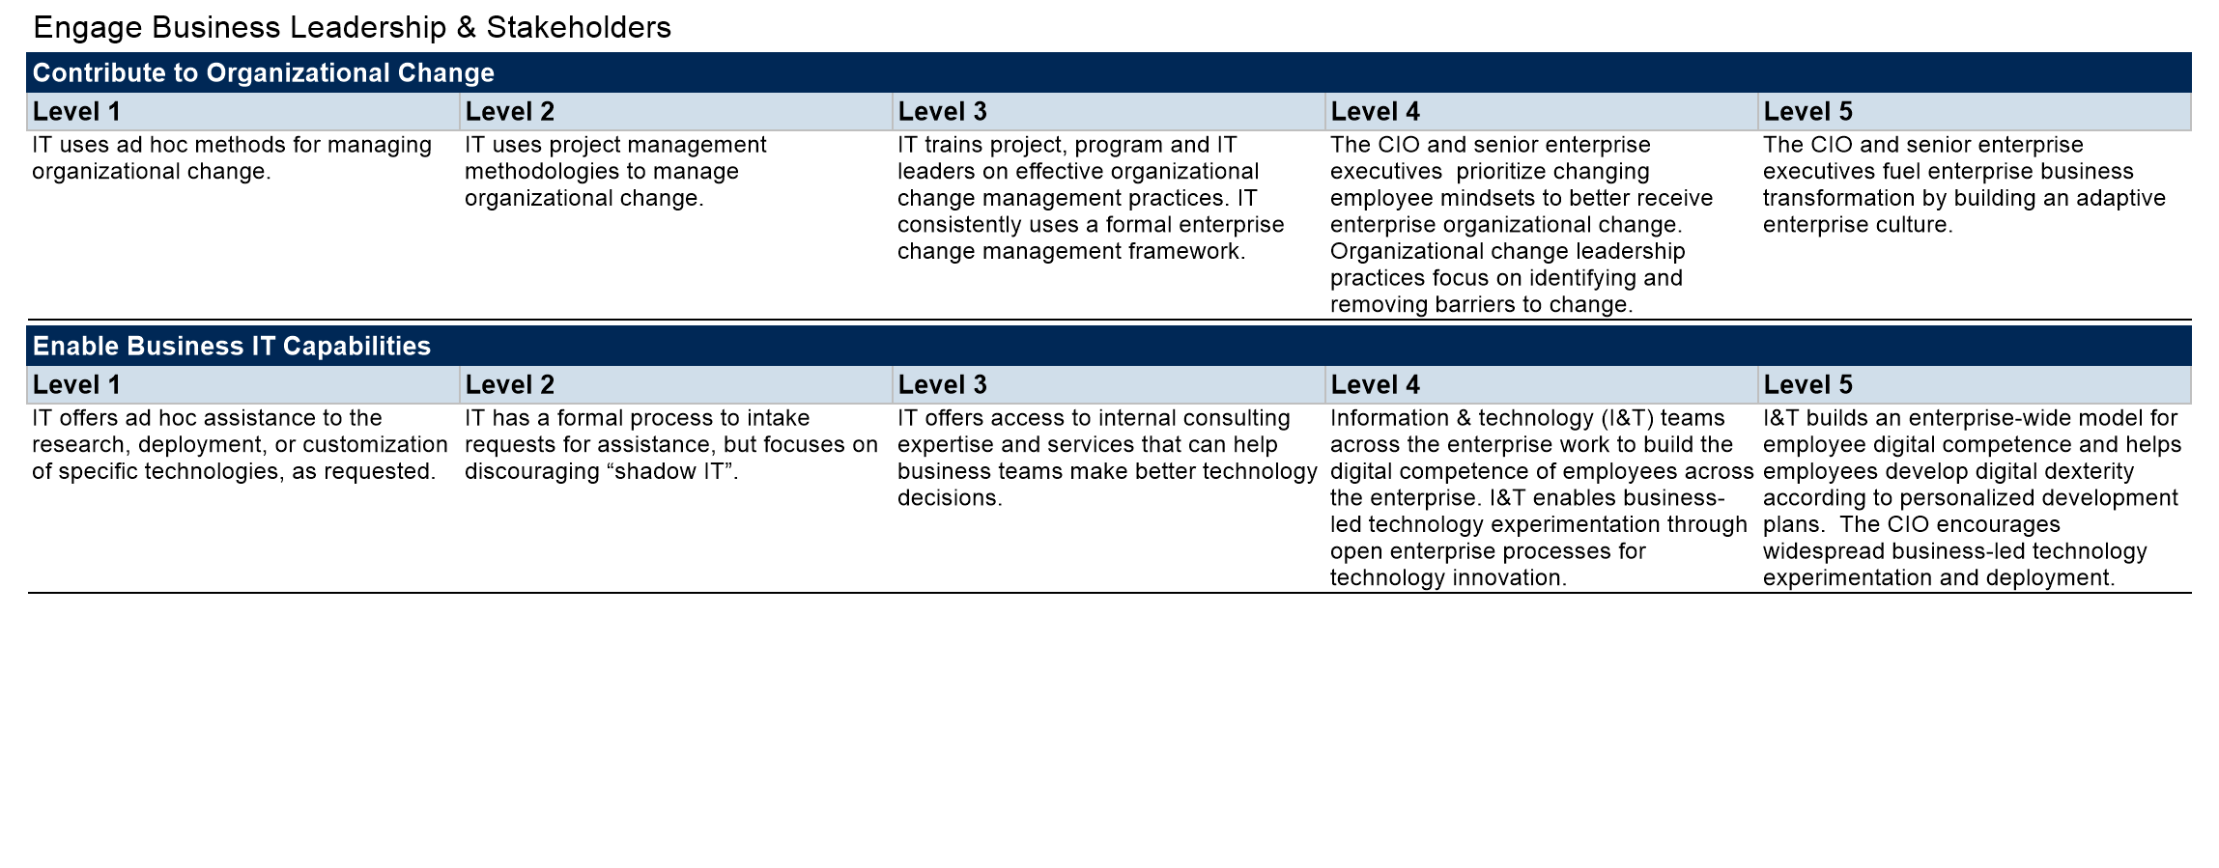
Mature Level Definitions…Cont’d

Slide 140
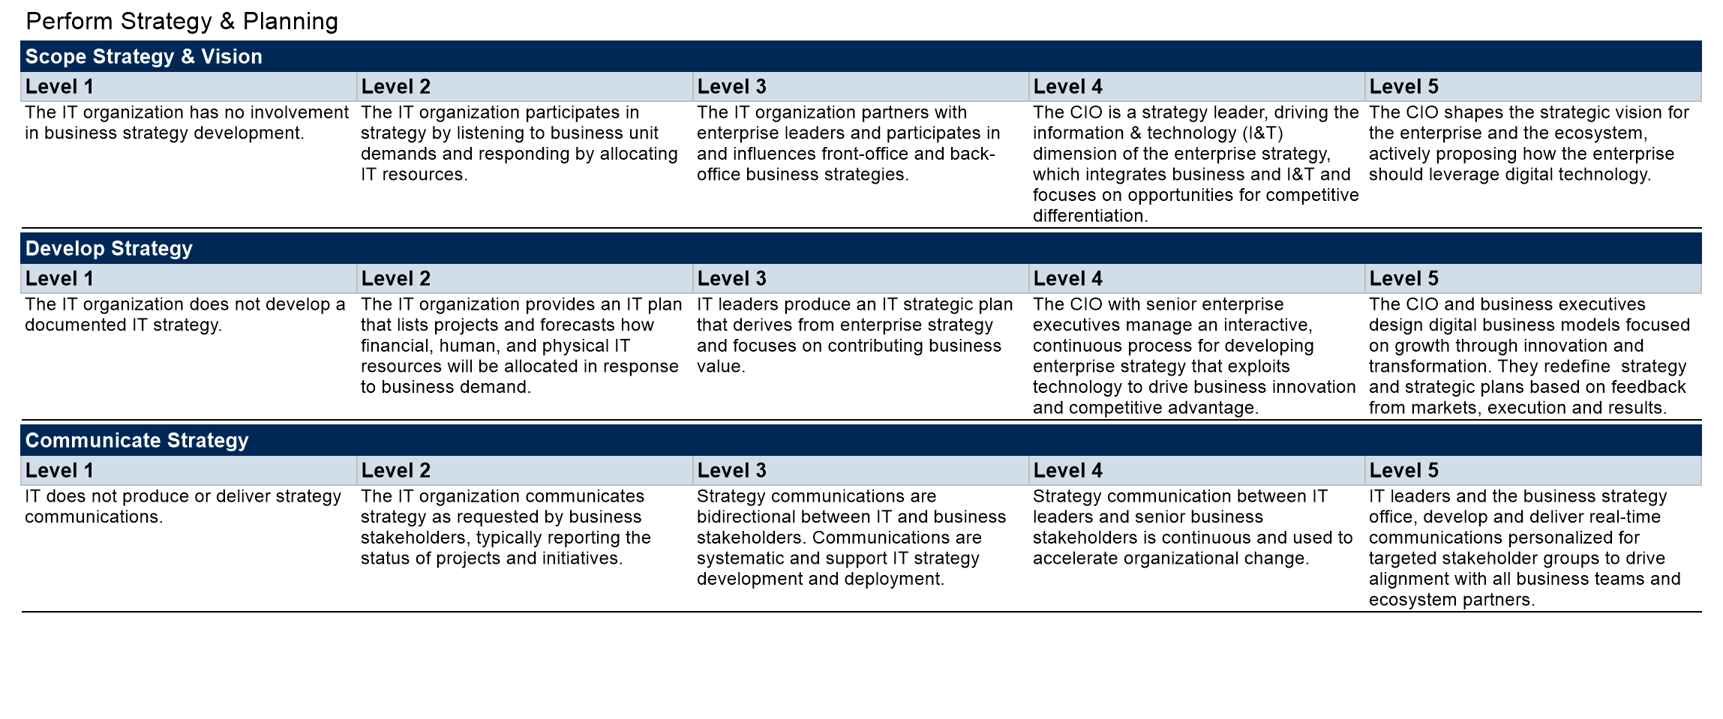
Mature Level Definitions…Cont’d

Slide 141
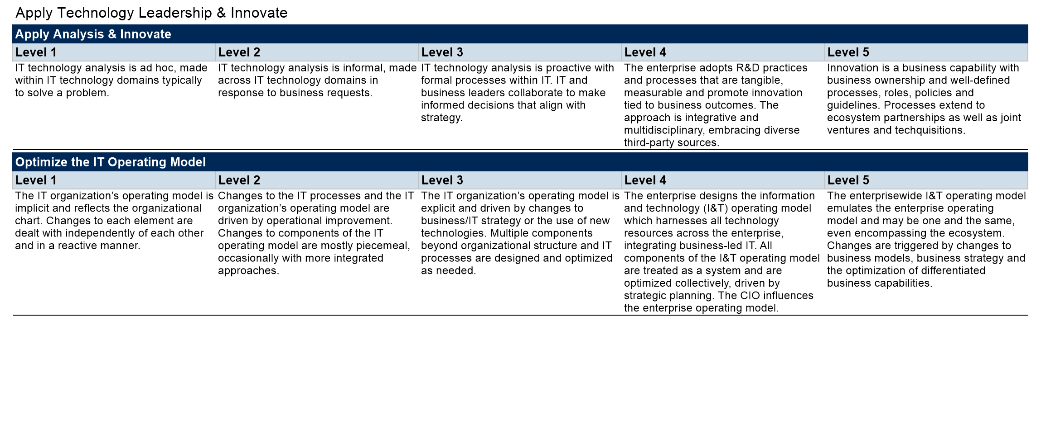
Mature Level Definitions…Cont’d

Slide 142

Mature Level Definitions…Cont’d

Slide 143

Mature Level Definitions…Cont’d

Slide 144

Mature Level Definitions…Cont’d

Slide 145

Mature Level Definitions…Cont’d

Slide 146

Mature Level Definitions…Cont’d

Slide 147

Mature Level Definitions…Cont’d

Slide 148

Mature Level Definitions…Cont’d

Slide 149

Mature Level Definitions…Cont’d

Slide 150

Mature Level Definitions…Cont’d

Slide 151

Team Consensus

Slide 152

Team Consensus…Cont’d

Slide 153

Team Consensus…Cont’d

Slide 154

Team Consensus…Cont’d

Slide 155

Team Consensus…Cont’d

Slide 156

Team Consensus…Cont’d

Slide 157

What are the High Priority Areas for our Function? (Leader Scores Only)

Slide 158

Digital Ambition

Slide 159

Functional Activity Map for IT Score or CIOs

Slide 160

Methodology Details

Slide 161

Calculation of Maturity Scores

Slide 162

Calculation of Maturity Scores…Cont’d

